Slide 1
Welcome
RIIO-ED2 Business Plan:
Final submission to Ofgem
Our webinar will begin in a few minutes.
Please use the Q&A button to post your questions about the business plan.
We will try to answer as many questions as possible at the end of presentation.
15 December 2021
westernpower.co.uk

Slide 2
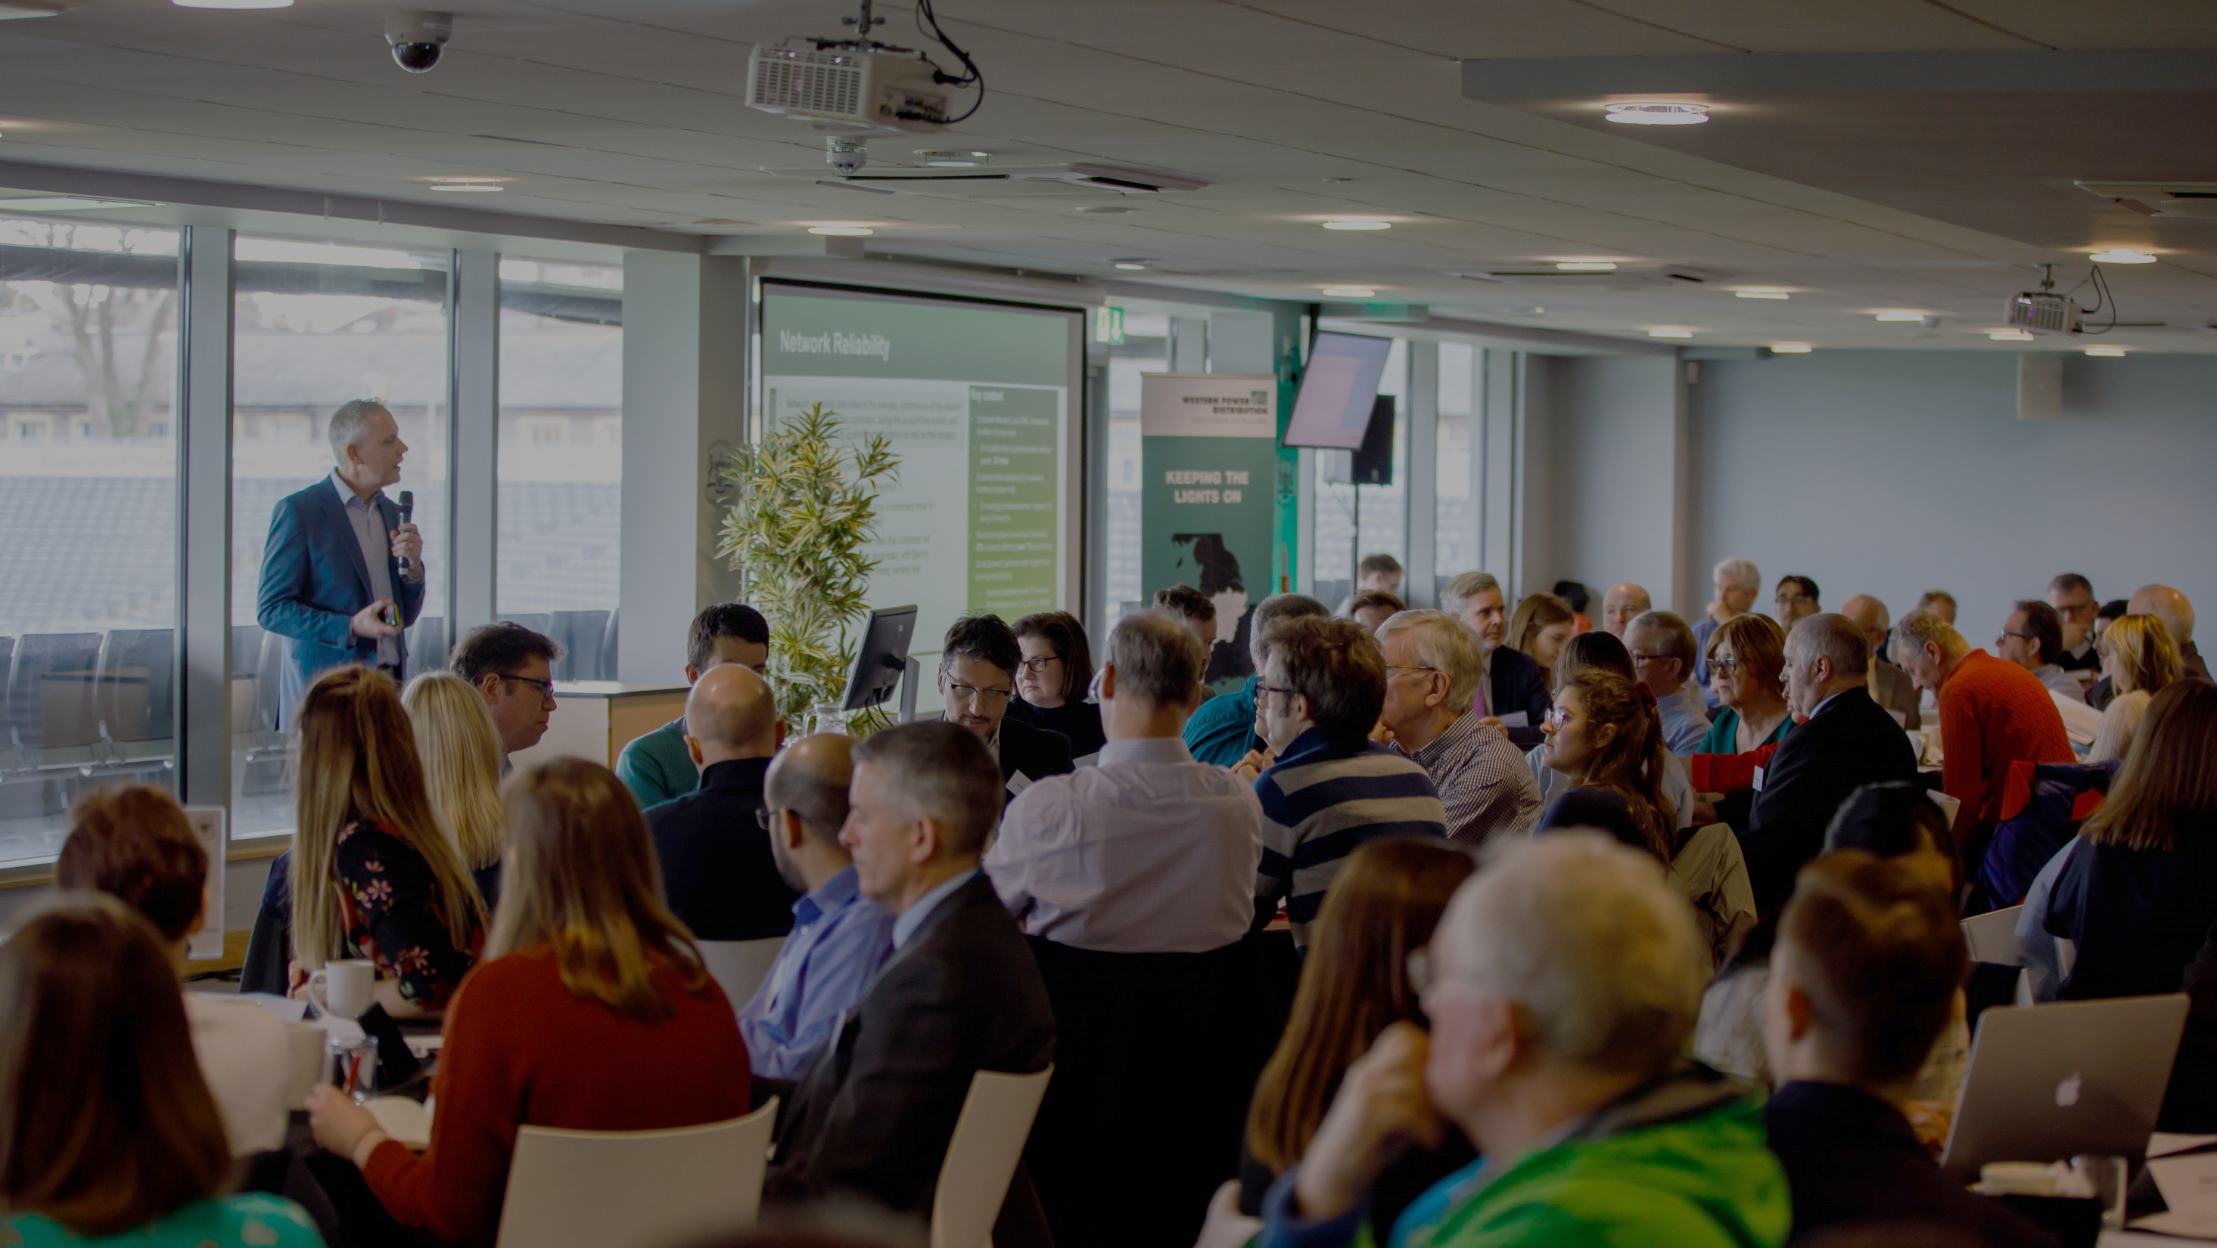
Introducing WPD’s final submission Business Plan
to Ofgem
Mark Shaw
RIIO-ED2 Business Plan Manager
Wednesday 15 December 2021
westernpower.co.uk

Slide 3
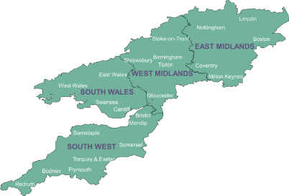
Setting the scene
We distribute power to 8 million homes & businesses
Covering the East and West Midlands, South Wales and South West England
Our focus is to deliver affordable excellent customer service by keeping the lights on and ensuring customers can have a connection when they want it.
Ofgem regulates how much revenue we can earn and what we must deliver in ‘price control periods’
RIIO-ED2 will cover the 5 years 2023-2028
We are developing our Business Plan for that period - setting out, in detail, our commitments to stakeholders, performance targets and planned investment and expenditure
RIIO-ED2:
Revenue = Incentives + Innovation + Outputs (Electricity Distribution 2)
westernpower.co.uk

Slide 4
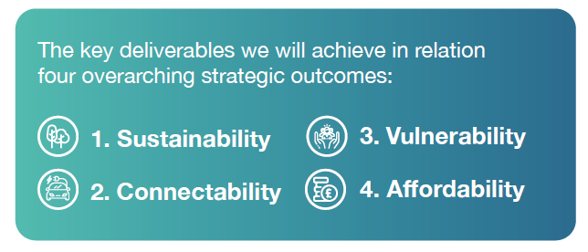
An ambitious vision for the future
Western Power Distribution (WPD) is leading an energy revolution; delivering a smart, digitalised electricity grid by 2028
We will drive the nation’s ambition of net zero carbon emissions, accelerate the shift to electric vehicles and roll out flexibility services.
This will ensure we maximise the efficiency of the existing network before we build more infrastructure.
Our Plan has been co-created with 25,000 stakeholders.
We will deliver exceptional service for our 8 million bill paying customers and future customers.
westernpower.co.uk

Slide 5
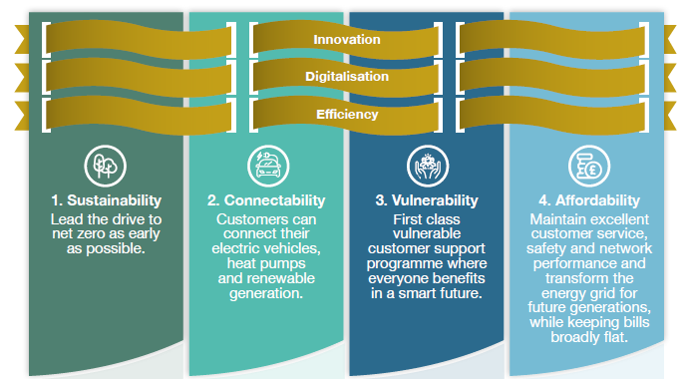
An ambitious vision for the future
Our Business Plan contains 42 core commitments and over 400 wider commitments that we will deliver in RIIO-ED2 while keeping bills broadly flat
We will achieve the key deliverables based on four strategic outcomes, which have three ‘golden threads’ running through each:
westernpower.co.uk

Slide 6
Sustainability
Leading the drive to net zero as quickly as possible
Regions achieve net zero by as early as 2028
with network capacity available to match stakeholder aspirations
Plus an ambitious set of core commitments, including:
130 local authorities actively partnered
WPD will be a net zero business by 2028
To deliver ambitious Local Area Energy Plans
90 local energy surgeries a year
Cutting our own business carbon footprint
Setting an ambitious science based target in line with a 1.5ºC global target (versus 2ºC)
Unlock capacity from the existing
grid and therefore avoid the need for reinforcement
Achieve a 10% net gain in biodiversity
Develop an industry leading DSO capability
‘Flexibility first’ approach – saving at least £94m
Six monthly flexibility tenders
Net gain for major projects works
Reduction in SF₆ (20%) and fluid filled cable (50%) leaks
westernpower.co.uk

Slide 7
Connectability
Customers can easily connect their EVs, heat pumps and renewable generation
Plus an ambitious set of core commitments, including:
Ready for at least an additional 1.5 million electric vehicles and 600,000 heat pumps by 2028.
Huge uplifts in community energy with 30 new schemes a year
Ensure customers are able to connect low carbon technologies quickly and easily
Actively support the expansion of green, renewable energy generation
Help communities to decarbonise and lower bills
Innovative uncertainty mechanisms ensure our plan is
highly adaptive
Whole systems approach to drive best outcomes for customers
We will deliver a network to meet the evolving
needs of our customers
Align our future energy forecasts with the plans of local regions and the ESO.
Three regional collaboration trial schemes by 2025 involving gas, electricity, water, waste, transport and heating sectors.
westernpower.co.uk

Slide 8
Vulnerability
A first class customer support programme where everyone benefits in a smart future
No one left behind in the smart future
with 600,000 smart energy action plans for vulnerable customers each year
Plus an ambitious set of core commitments, including:
Support at least 113,000 fuel poor
customers to save £60 million on
their energy bills
£540,000 shareholder funded support per year to install solar PV on schools deprived areas
Working with more than 120 community-based partner agencies
Build decarbonised communities and local energy schemes
Expand the reach of our PSR to at least 75% of the total eligible
£1 million shareholder-funded ‘Community Matters’ social
initiative ever year
Plus 80% of customers with critical medical dependencies
Register at least 50,000 additional ‘hard-to-reach’ customers each year.
Support the smart energy transition, vulnerability, environment and sustainability.
1,000 volunteer days per year for WPD staff to support local causes.
westernpower.co.uk

Slide 9
Affordability
Keeping bills broadly flat whilst maintaining excellent customer service, safety and network performance and transforming the energy grid for future generations
Plus an ambitious set of core commitments, including:
£818 million of efficiencies included in our Business Plan
Achieve an overall average customer satisfaction of 93%
or higher by the end of RIIO-ED2
Ongoing efficiency saving of £95 million
On top of £723m of efficiencies already included
With separate reporting for emerging technology customers.
Increase the safety of around 200,000 children by delivering 780 safety schemes to underground
108% increase in load related schemes with only an 8% increase in engineering management
Insulate or divert overhead lines that cross school playing areas.
Utilise innovation and digitalisation to drive efficiency in all we do
westernpower.co.uk

Slide 10
Expenditure
We propose to invest around £6.7 billion in the network across the period 2023-2028
This is an increase of around £1.4 billion from current levels
This will result in significant benefits to customers and deliver the priorities of our stakeholders and the outcomes they value
It will also move us towards the achievement of Net Zero carbon emissions in the UK
westernpower.co.uk

Slide 11
Customer bills
Customers currently pay around £98 a year for the WPD portion of an average domestic electricity bill.
We expect this to remain broadly at the same level in RIIO-ED2 despite significant increases in expenditure and stretching service improvement targets.
.
We estimate the impact of the increase would result in an approx. £3.37 increase on the average domestic bill.
However, we intend to offset this by our efficiencies, changes to the financing parameters and other aspects of the RIIO-ED2 framework.
Key:
westernpower.co.uk

Slide 12
How our plan was built
Our final Business Plan submission to Ofgem is the fourth version of the Plan overall
Our Business Plan has been co-created with over 25,000 stakeholders across 280 events, starting from a blank piece of paper.
It has included significant numbers of bill paying and future customers from diverse locations and backgrounds.
January 2021
BP1 published and consultation
March 2021
BP2 published and consultation
July 2021
BP3 (first submission to Ofgem) published and consultation
80-82%
end user acceptability
of the overall plan
(only 4% “unacceptable”)
87% - 97%
stakeholder acceptability of WPD’s core commitments
December 2021
BP4 (final submission to Ofgem) published
westernpower.co.uk

Slide 13
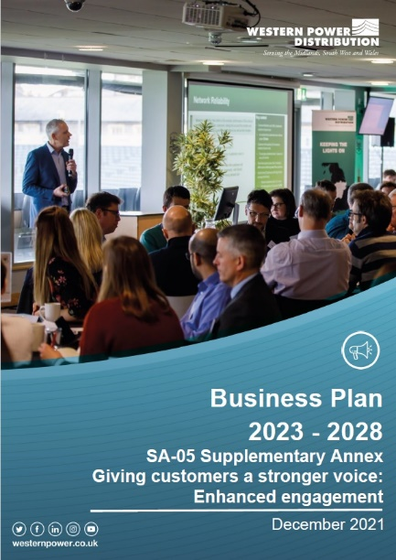
What we have published
www.westernpower.co.uk/RIIO-ED2BusinessPlan
core documents
supplementary annexes
key strategies
6
13
22
Governance
Our commitments
2a. Justification
Smart and flexible network
Keeping promises
Engagement
6/6a. Expenditure
Uncertainty
Competition
Financing
Glossary
Investment appraisal
Including:
Innovation and efficiency
Customer vulnerability
Digitalisation
DSO
Electric Vehicle
Environment
Environmental Action Plan
Major connections
Social contract
Workforce resilience
RIIO-ED2 Business Plan
RIIO-ED2 Business Plan
Fact Sheet
Business Plan Overview
Navigating our Plan
Board Assurance Statement
Redaction Explanatory Statement
westernpower.co.uk

Slide 14
An ambitious vision for the future
In summary
We will therefore keep bills broadly flat despite major uplifts in expenditure.
By utilising innovation and digitalisation in all we do we will drive huge levels of efficiency.
In RIIO-ED2 we will dramatically accelerate the rate of this change, placing customers at the heart of a swift and effective transition to a smart, decarbonised energy future.
Change is already well underway, with unprecedented levels of flexibility, efficiency and new distribution system operator capabilities already in place.
We will deliver 42 ambitious core commitments and over 400 wider commitments.
Our plan has exceptionally high levels of customer acceptability.
Our track record of delivery in RIIO-ED1 (top performer in network reliability, customer service and DSO) means we can be trusted to deliver for our customers.
westernpower.co.uk

Slide 15
Next steps
ANY QUESTIONS?
Thank you very much for time and input into our process
westernpower.co.uk

Slide 16
www.westernpower.co.uk/
RIIO-ED2BusinessPlan

