Slide 1






Welcome
RIIO-ED2 second draft Business Plan
Our webinar will begin in a few minutes.
Please use the Q&A button to post your questions about the business plan.
We will try to answer as many questions as possible at the end of presentation.
30 March 2021
westernpower.co.uk

Slide 2
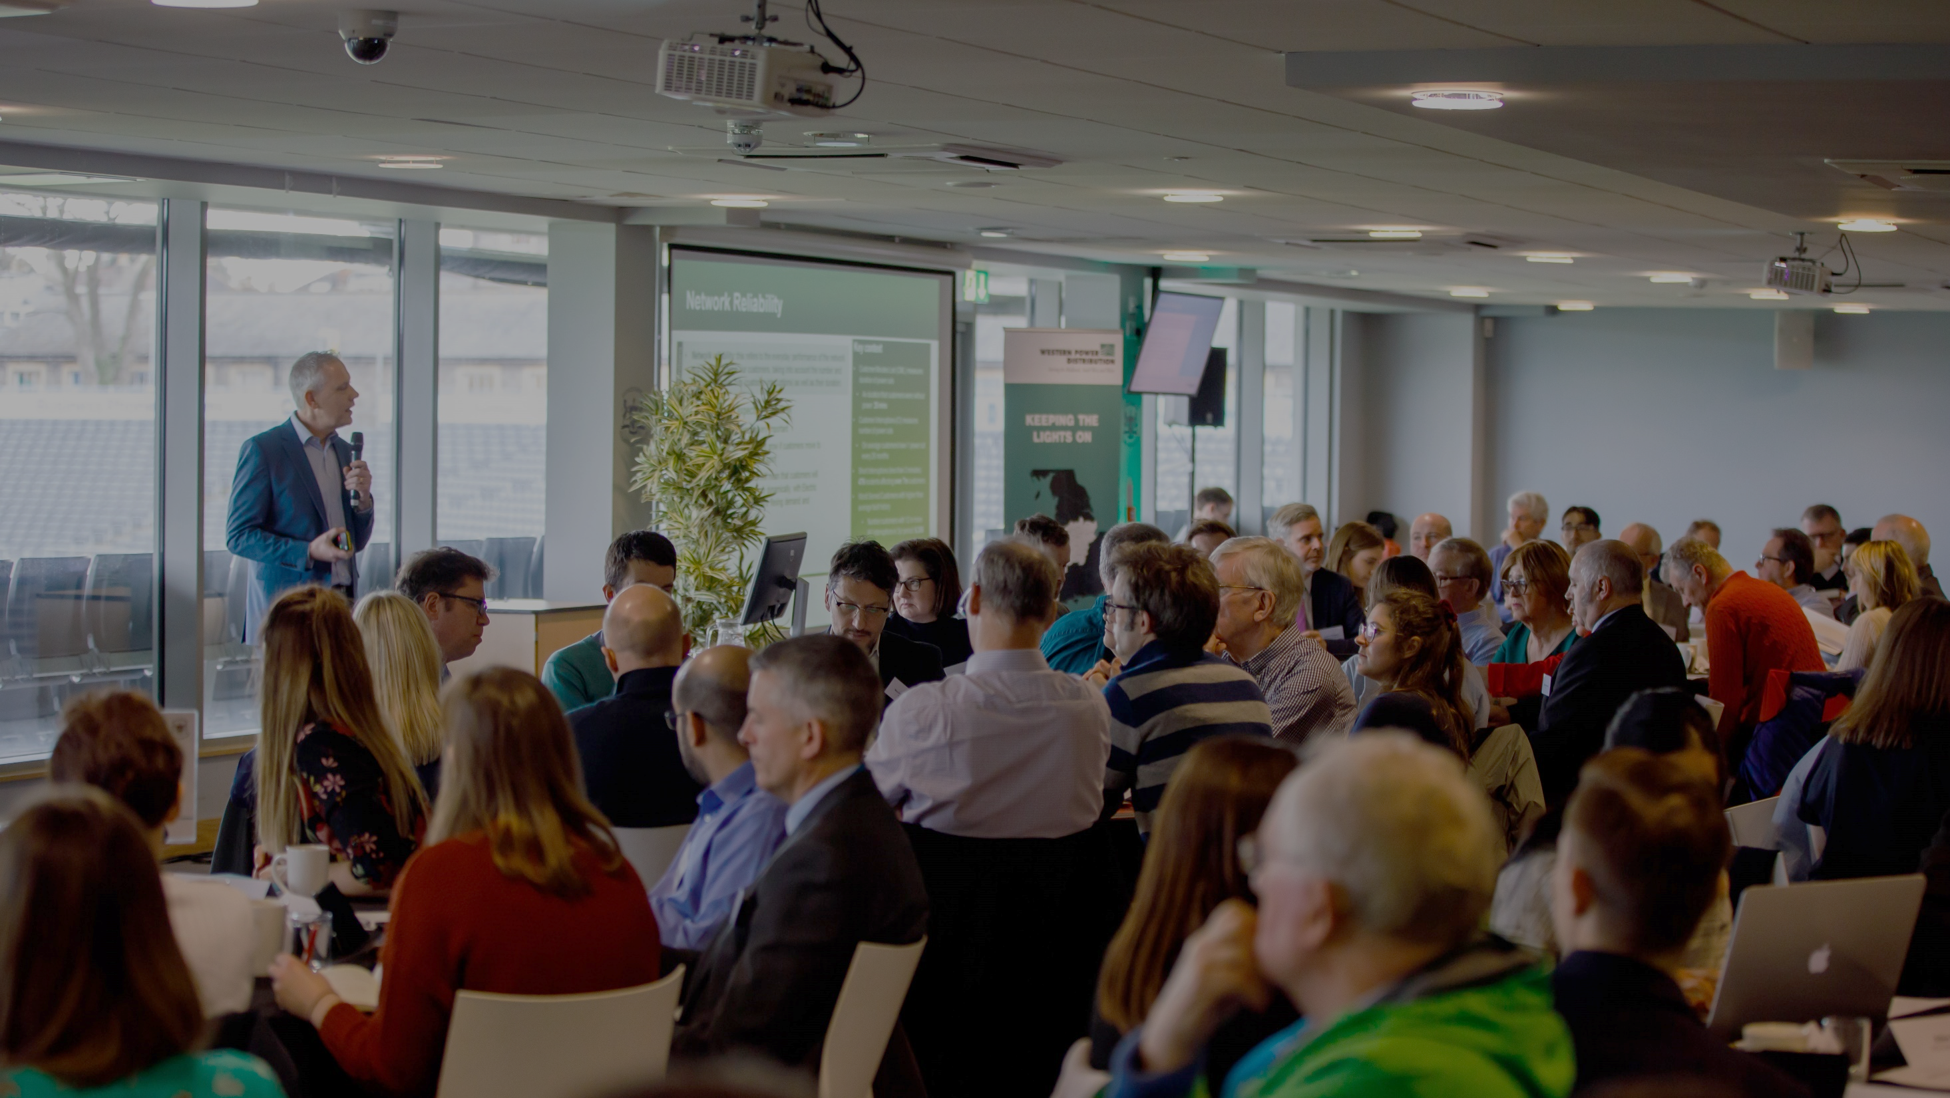






Introducing WPD’s Second Draft Business Plan for RIIO-ED2
Mark Shaw
RIIO-ED2 Business Plan Manager
Tuesday 30th March
westernpower.co.uk

Slide 3
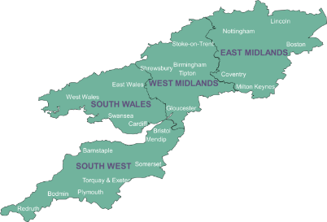



Setting the scene
We distribute power to 7.9 million homes & businesses
Covering the East and West Midlands, South Wales and South West England
Our focus is to deliver affordable excellent customer service by keeping the light on and ensuring customers can have a connection when they want it.
Ofgem regulates how much revenue we can earn and what we must deliver in ‘price control periods’
“RIIO-ED2” will cover the 5 years 2023-2028
We are developing our Business Plan for that period - setting out, in detail, our commitments to stakeholders, performance targets and planned investment and expenditure
“RIIO-ED2”:
Revenue = Incentives + Innovation + Outputs (Electricity Distribution 2)
westernpower.co.uk

Slide 4
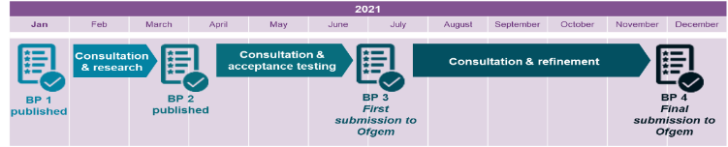
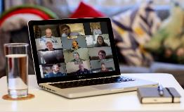

Our stakeholder engagement programme
We are building a Plan that is entirely reflective of stakeholder needs and priorities
Four published versions for stakeholders:
We are maximising the opportunities for stakeholders to co-create our Plans before final submission to Ofgem on 1st December 2021:
Over 9,600 stakeholders have now had their say (over 5,700 via direct, in-person engagement):
>2,200 consultation responses in the last eight weeks alone
  Covering a wide cross-section of stakeholders, via qualitative and quantitative events
  E.G. Bill payers, future users, industry parties, local authorities, green energy organisations, consumer groups, charities and many more
westernpower.co.uk

Slide 5


What we have published
We have added further detail in a number of areas and are seeking views on material changes following stakeholder feedback to BP1
Second draft Business Plan
Accompanying consultation
Business Plan Chapters
Ch 1 | A summary of our plan
Ch 2 | We deliver on our commitments
Ch 3 | *updated* Giving consumers a stronger voice
Ch 4 | *updated* Our RIIO-ED2 core commitments
Ch 5 | *updated* Delivering a smart, flexible energy system
Ch 6 | *updated* Proposed RIIO-ED2 expenditure
Ch 7 | *new* Managing uncertainty
Ch 8 | *new* Competition
Ch 9 | *new* Financing our Plan
Ch 10 | Glossary
Greater focus on the Business Plan at large this time (BP1 was was more centred on the core commitments):
Summary of Business Plan in <10 pages
Overview of the 58 core commitments
14 consultation questions for you to respond to
westernpower.co.uk

Slide 6


Headlines of our plan - Expenditure
Some aspects of our second draft are largely consistent with the first:
EXPENDITURE:
We propose to invest around £6 billion in the network across the period 2023-2028 to deliver WPD’s current view
This is an increase of around £835 million from current levels
This will result in significant benefits to customers and deliver the priorities of our stakeholders and the outcomes they value
It will also move us towards the achievement of Net Zero carbon emissions in the UK
CUSTOMER BILLS:
Increased expenditure would result in an approximate £1.95 increase on the average domestic bill (£1.50 as in BP1; +£0.45 as a result of increased commitment ambitions)
However, we predict this will be offset by our efficiencies, changes to the financing parameters and other aspects of the RIIO-ED2 framework.
We therefore intend to keep bills broadly flat across the five year period 2023-2028, in line with present day.
£96
a year for the average domestic customer
westernpower.co.uk

Slide 7
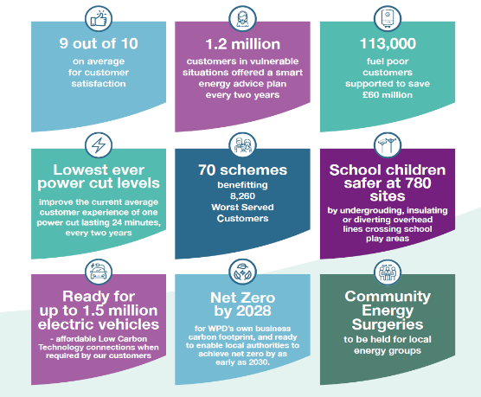




Headlines of our plan - Commitments
And some aspects have seen a significant shift in response to feedback:
58 STREAMLINED CORE COMMITMENTS (reduced from 67)
 | 4 new commitments created
 | 35 commitments (60%) more ambitious
 | 11 commitments reworded (clearer outcomes and measurability)
westernpower.co.uk

Slide 8



Headlines of our plan – Commitments (2)
We are now working through BP2 to incorporate these changes
35 commitments (60%) more ambitious
e.g.
BP1 commitment | BP2 proposed commitment
Support 75,000 fuel poor customers to save £40 million on their energy bills over RIIO-ED2 | Support 113,000 fuel poor customers to save £60 million on their energy bills over RIIO-ED2
4 new commitments created
e.g.
Ensure capacity availability to enable Net Zero to be achieved across our regions sooner than 2050 (some areas as soon as 2030), in line with the ambitions of stakeholders in each region.
11 commitments reworded (clearer outcomes and measurability)
e.g.
BP1 commitment | BP2 proposed commitment
Underground, insulate or divert overhead lines that cross school or other playing areas. | Reduce the risk of injury or harm to children by delivering 780 schemes (43% of total locations) to underground, insulate or divert overhead lines that cross school playing areas, targeting the highest risk sites first
westernpower.co.uk

Slide 9
Headlines of our plan – Best View of future energy needs
Careful, accurate planning is essential so we can ensure our network is ready for new and increased demand
WPD is key to the UK achieving Net Zero and driving customer uptake of low carbon technologies (LCTs)
We’re building a ‘bottom-up’ forecast of future electricity use – WPD’s Distribution Future Energy Scenarios (DFES)
  Aligned with the national Future Energy Scenarios
Close collaboration with local authorities and stakeholders to ensure forecasts reflect their regional low carbon plans
We plan to connect up to a further
1.5 million electric vehicles
and 600,000 heat pumps
We have a key role to influence consumer behaviour, harness new innovation and operate the existing network more flexibly
We’ll spend an extra £106 million to continue our work to create a smarter, more secure, digitalised grid
We will deliver a ‘flexibility first’ approach to reinforcement, using innovation to maximise the efficiency of the existing network
westernpower.co.uk

Slide 10
Fourteen questions we’d like you to answer
We’ve made it as easy as possible to feedback in just 2 clicks from our homepage
But it’s so important that you do – this is the last opportunity to feedback before we submit to Ofgem for the first time
You can provide free-text responses, as well as quantitative votes to summarise your preferences
Based on the consultation document only:
Based on the second draft Business Plan:
Qu.
1
Overall acceptability of the Plan
Qu.
2-3
Potential bill impact
Qu.
4-5
WPD’s Best View of future energy needs
Presentation and accessibility of the Business Plan
Qu.
8-9
Covering:
Qu.
6-7
Our expenditure for RIIO-ED2
Qu.
10-11
Core Commitments
Qu.
12-14
New commitments (since BP1)
westernpower.co.uk

Slide 11



What we’re asking you to do
www.westernpower.co.uk/RIIO-ED2-Business-Plan-Mar2021
Download and review our full Business Plan draft
If you’re time-pressed, review our consultation document
How to respond to this consultation:
You can submit your responses directly online:
Or download a response form and return to us:
Visit:
www.westernpower.co.uk/RIIO-ED2-Business-Plan-Mar2021
Email:
yourpowerfuture@westernpower.co.uk
Write:
Stakeholder Team, Western Power Distribution, Herald Way, Castle Donington, DE74 2TU
Closing date: Sunday 25th April
westernpower.co.uk

Slide 12
Next steps
ANY QUESTIONS?
Thank you very much for time and input into our process
westernpower.co.uk

Slide 13

www.westernpower.co.uk/RIIO-ED2-Business-Plan-Mar2021

