Slide 1
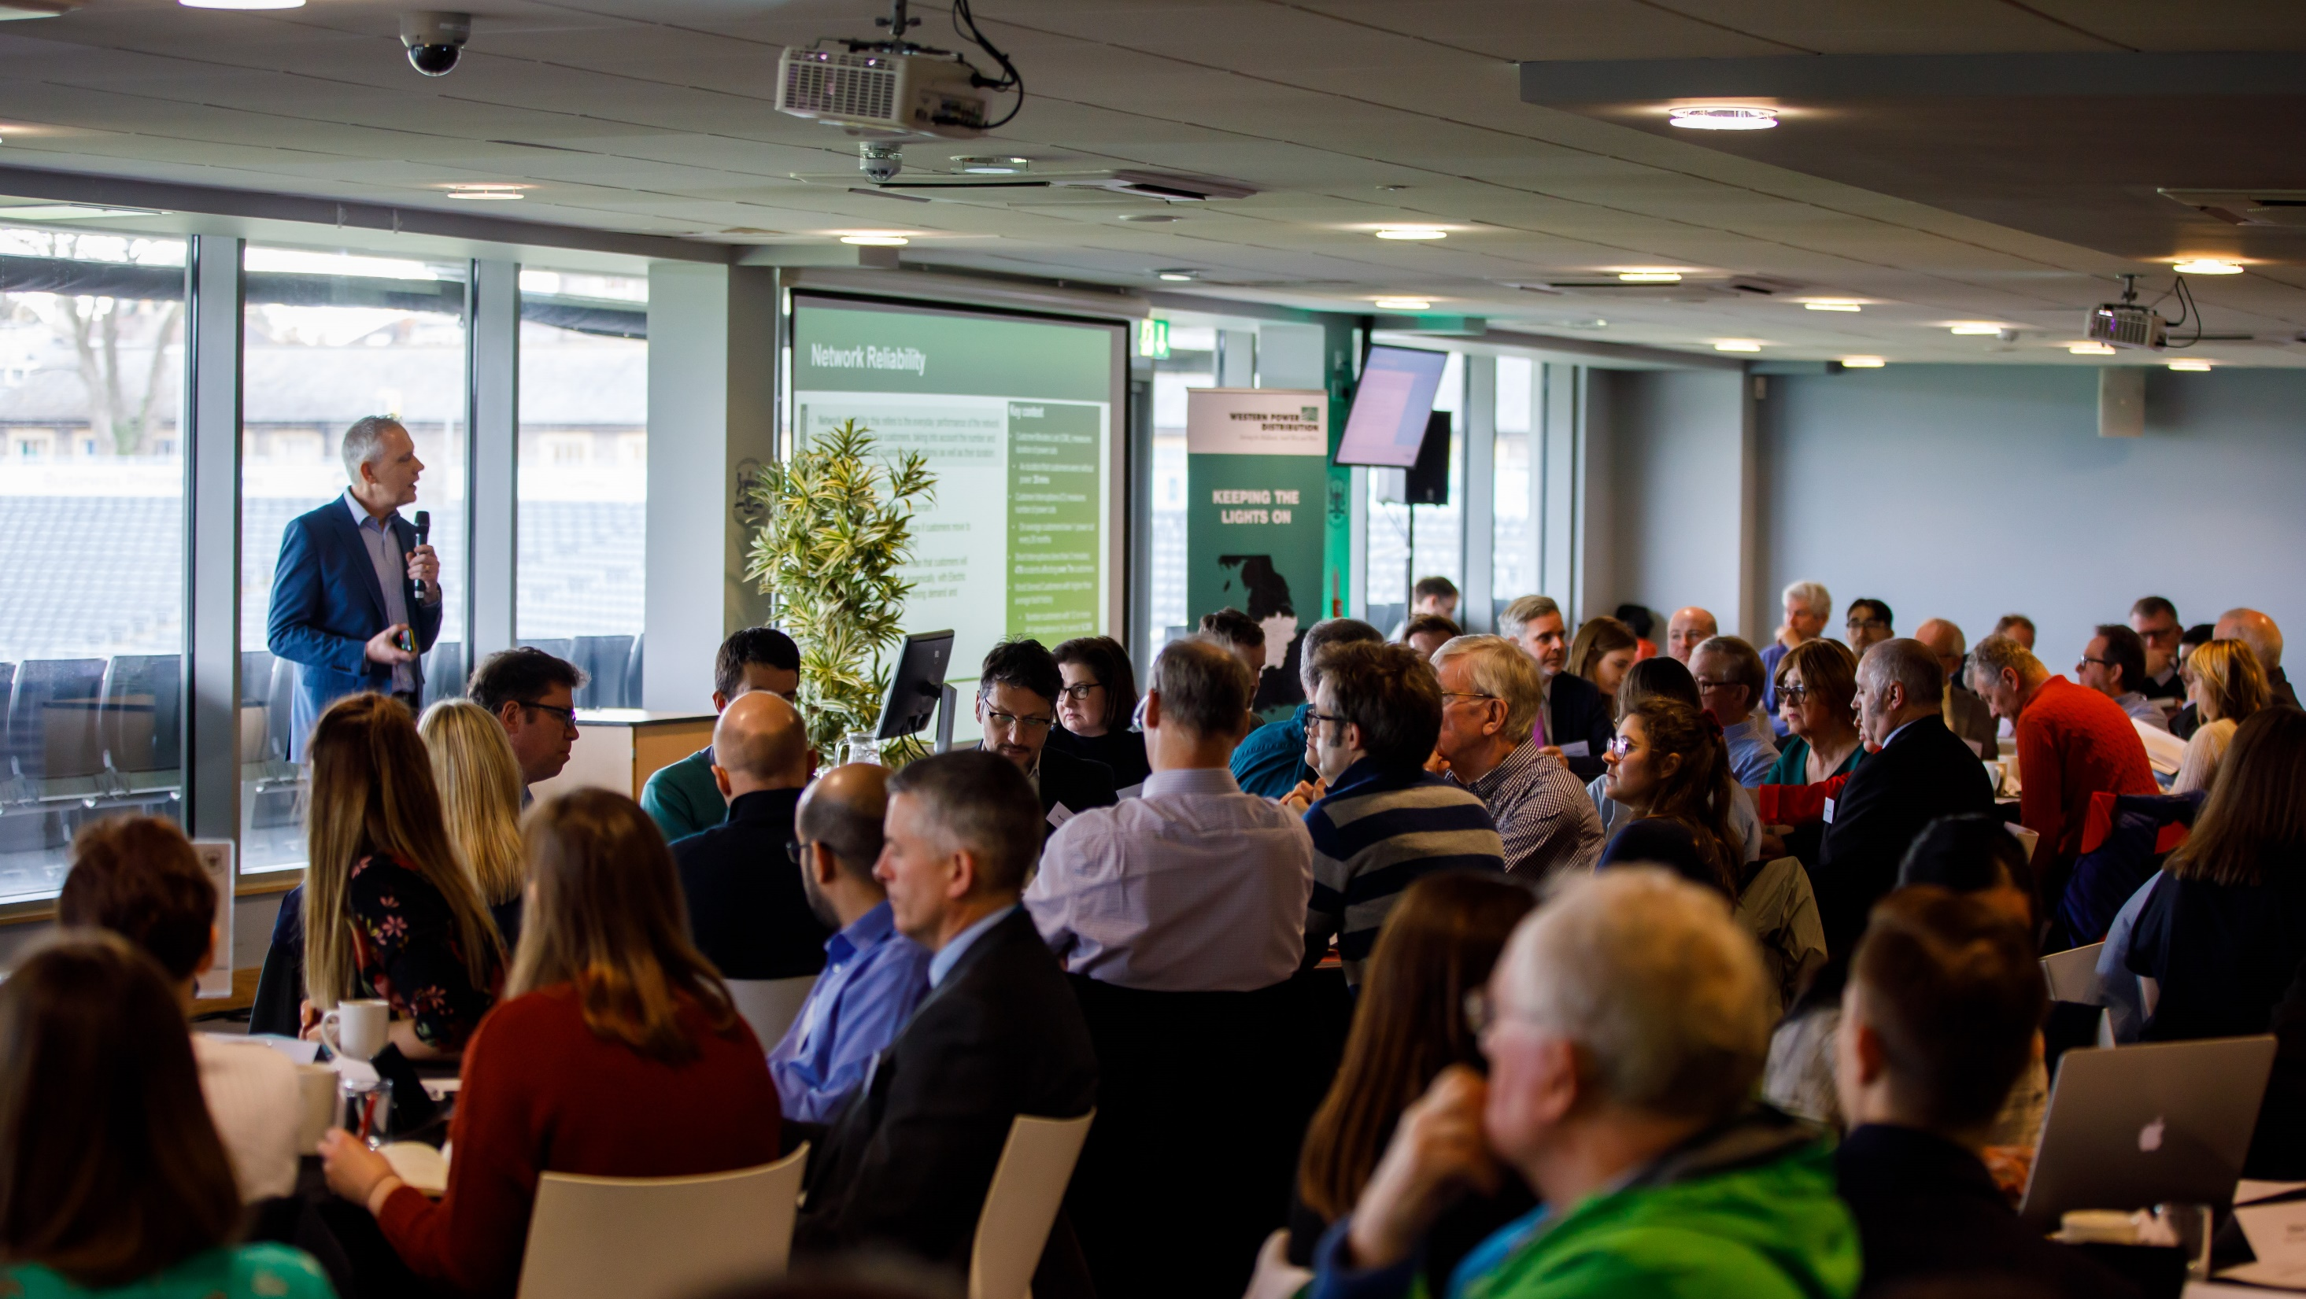


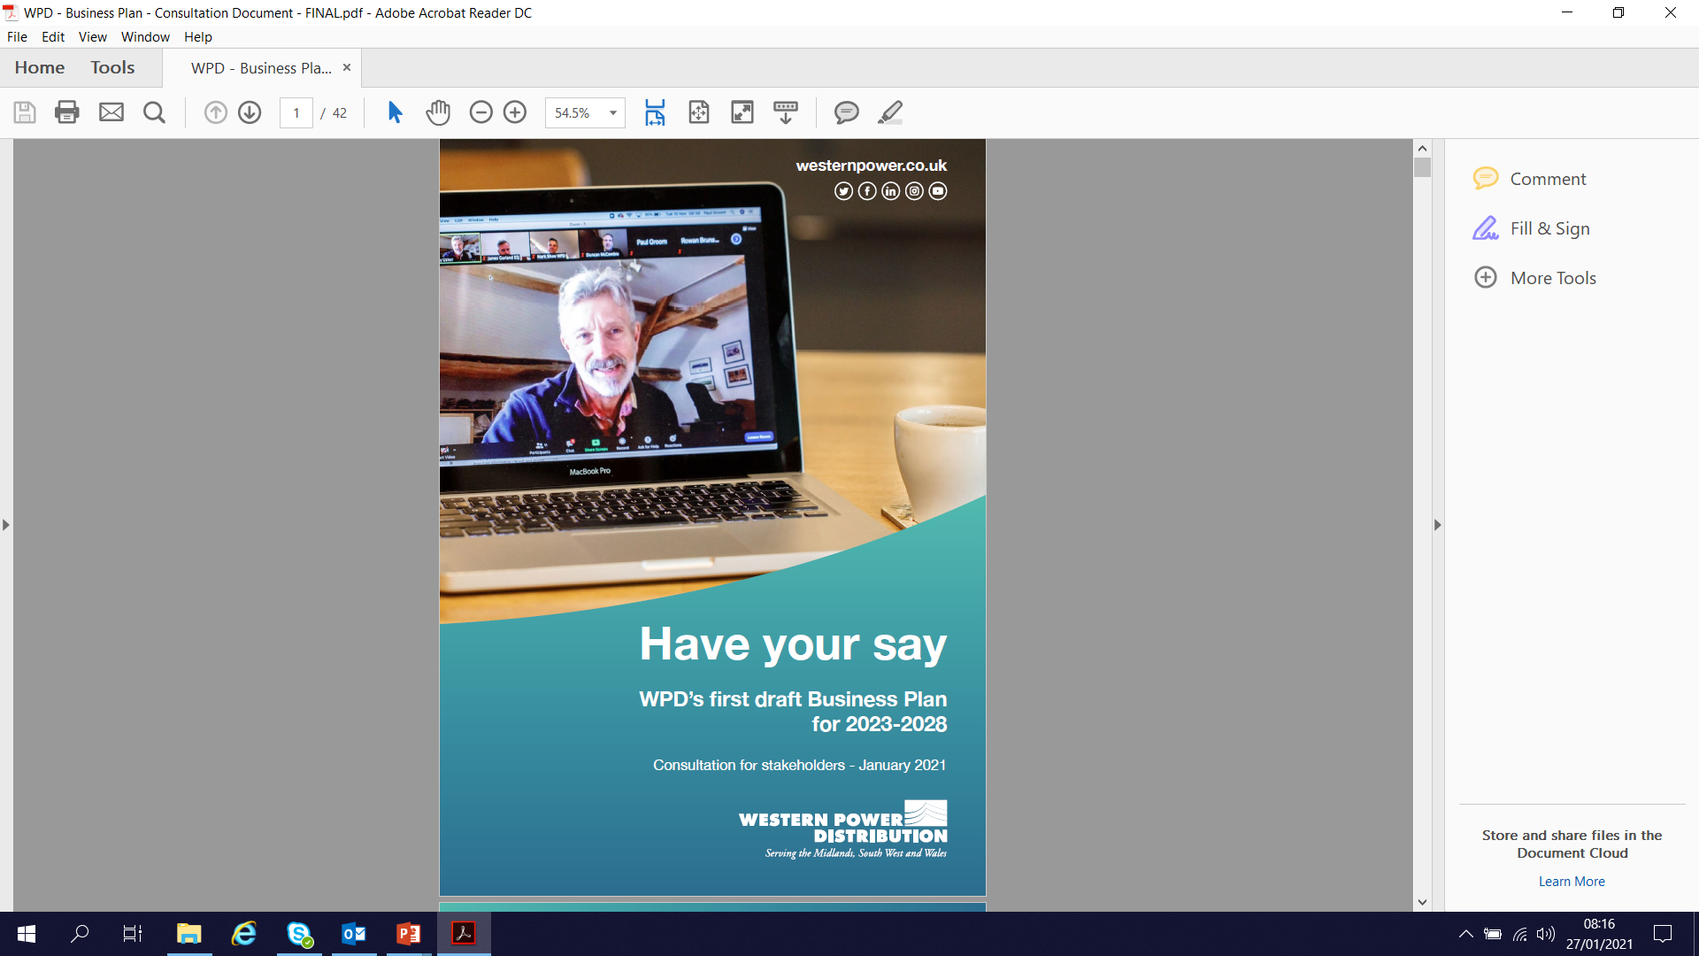
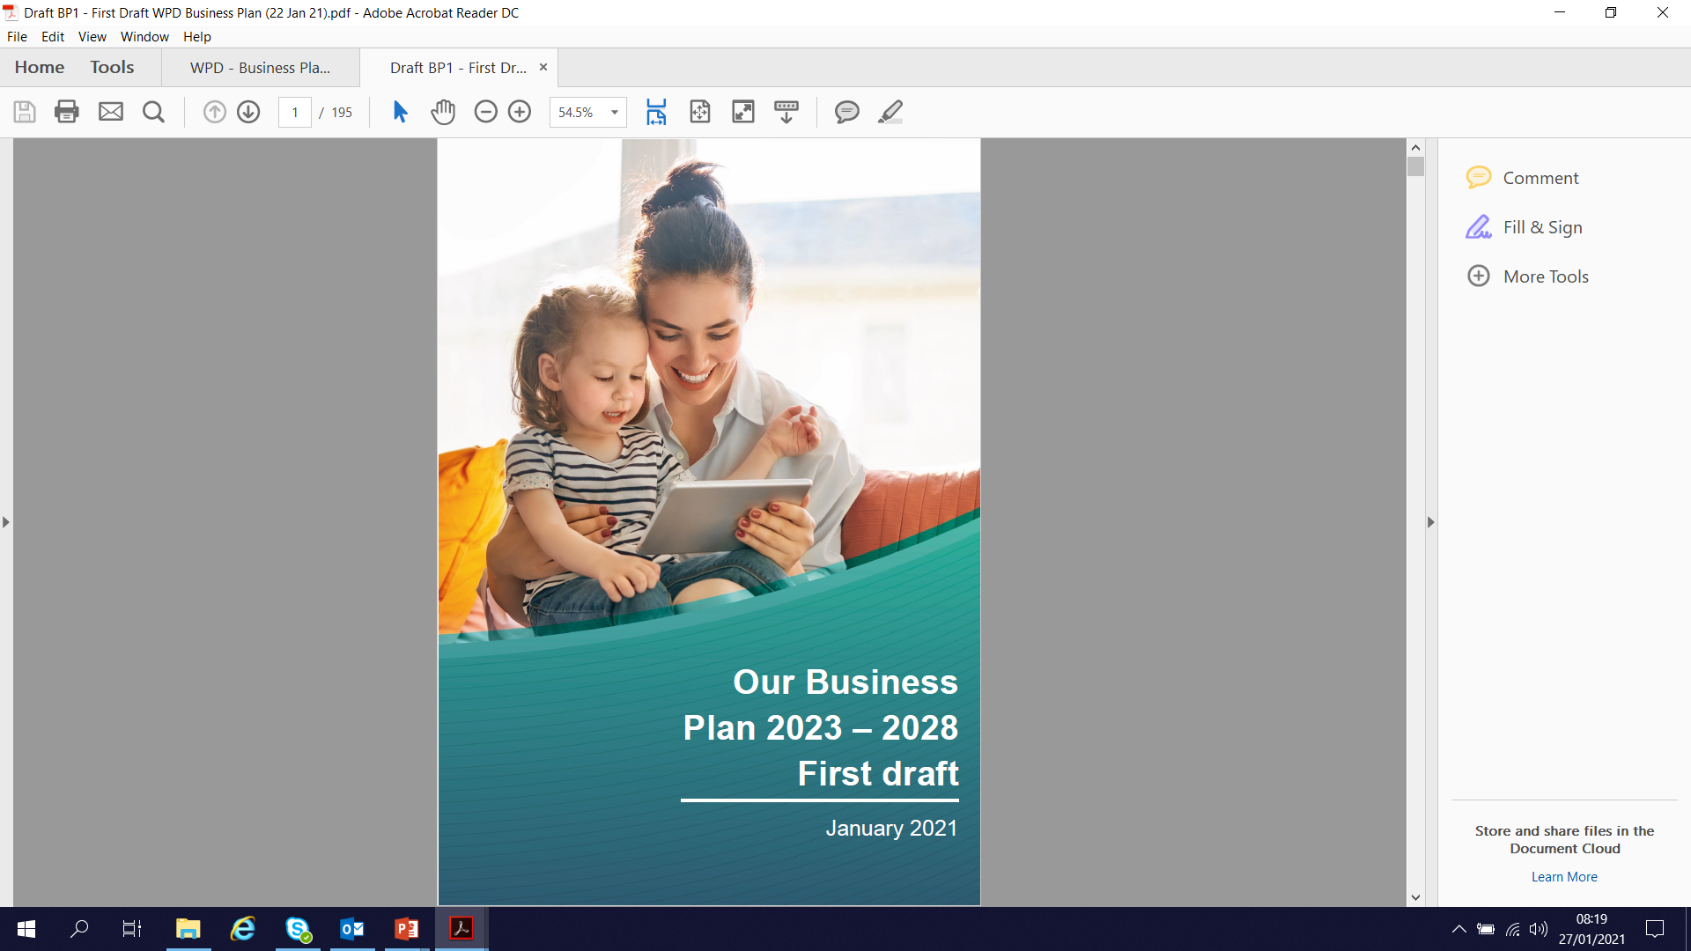


Introducing WPD’s First Draft Business Plan for RIIO-ED2
Mark Shaw
RIIO-ED2 Business Plan Manager
Wednesday 3rd February
westernpower.co.uk

Slide 2
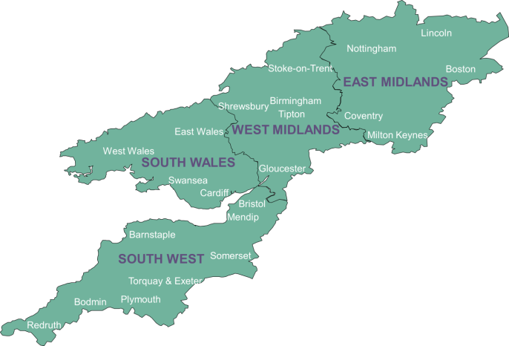



Setting the scene
We distribute power to 7.9 million homes & businesses
Covering the East and West Midlands, South Wales and South West England
Our focus is to deliver affordable excellent customer service by keeping the light on and ensuring customers can have a connection when they want it.
Ofgem regulates how much revenue we can earn and what we must deliver in ‘price control periods’
“RIIO-ED2” will cover the 5 years 2023-2028
We are developing our Business Plan for that period - setting out, in detail, our commitments to stakeholders, performance targets and planned investment and expenditure
“RIIO-ED2”:
Revenue = Incentives + Innovation + Outputs (Electricity Distribution 2)
westernpower.co.uk

Slide 3
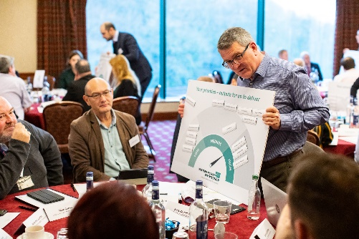
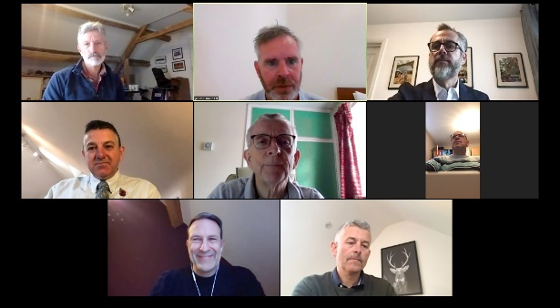
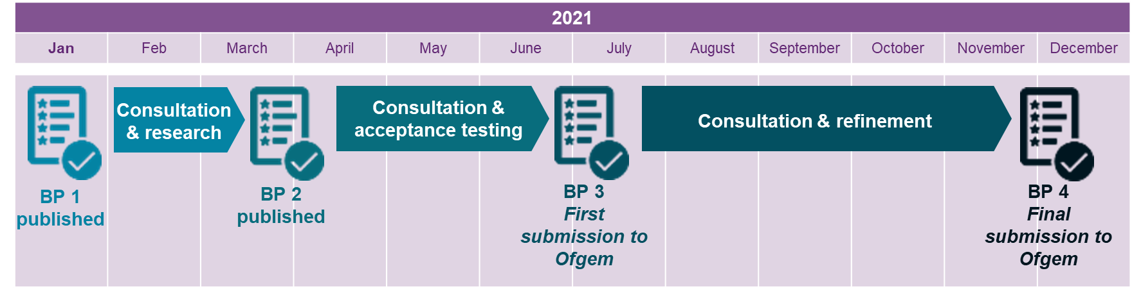
Our stakeholder engagement programme
Since 2019 we have engaged over 4,500 stakeholders on the creation of our Business Plan
  Bill payers, future users, industry parties, local authorities, green energy organisations, consumer groups, charities and many more
We will publish 4 versions of our Business Plan up to the final submission to Ofgem on 1st December 2021:

Slide 4

Co-creation with stakeholders
We want the best possible Business Plan in the eyes of our customers – entirely reflective of their needs and priorities
We are building our Business Plan with stakeholders in stages
We’re aiming for the greatest involvement of stakeholders ever – co-creating our Plan with stakeholders
Update our understanding of stakeholder priorities
Identify significant changes in expectations
Invite suggestions for how we can improve or evolve our operations
We started from a blank piece of paper
  Whilst in many cases the priorities suggested by stakeholders have not come as a surprise, starting afresh was an intentional approach to:
Every commitment in our first draft Business Plan is a result of stakeholder feedback
  In some cases feedback has developed the precise commitment and targets being proposed
  In others stakeholders indicated a general area of focus/priority. We have then suggested what we believe is an appropriate commitment.
We are now seeking your views on the precise targets and/or suggest alternative commitments

Slide 5
What we have published
First draft Business Plan
Accompanying consultation
Business Plan Chapters
Chapter 1 | A summary of our plan
Chapter 2 | We deliver on our commitments
Chapter 3 | Giving consumers a stronger voice
Chapter 4 | Our RIIO-ED2 core commitments
Chapter 5 | Delivering a smart, flexible energy system
Chapter 6 | Proposed RIIO-ED2 expenditure
Chapter 7 | Adapting to change
Chapter 8 | Glossary
Detailed overview of the 67 core commitments
13 consultation questions for you to respond to

Slide 6


Headlines of our plan
Expenditure
Customer bills
We propose to invest around £6 billion in the network across the period 2023-2028 to deliver WPD’s current view
This is an increase of around £1 billion from current levels (or +£0.2 billion per year)
This will result in significant benefits to customers and deliver the priorities of our stakeholders and the outcomes they value
It will also move us towards the achievement of Net Zero carbon emissions in the UK
Our calculations estimate the increased expenditure would result in an approximate £1.50 increase on the average domestic bill.
However, we predict that this will be offset by our efficiencies, changes to the financing parameters and other aspects of the RIIO-ED2 price control process.
We therefore intend to keep bills broadly flat across the five year period 2023-2028, in line with present day.
£96
a year for the average domestic customer

Slide 7
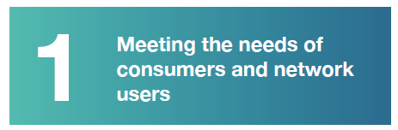
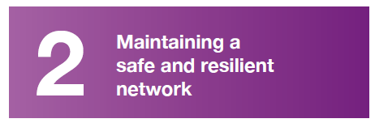
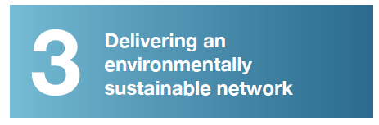
Headlines of our plan
67 core commitments
Within 3 categories:
Customer service
Customers in vulnerable situations
Connections
Social contract
Network resilience
Business IT security and cyber resilience
Safety
Workforce resilience
Environment and sustainability
A smart, flexible network
Innovation
Community energy

Slide 8
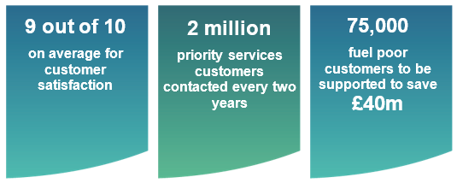
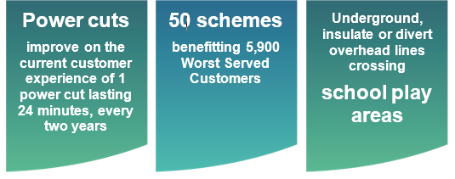


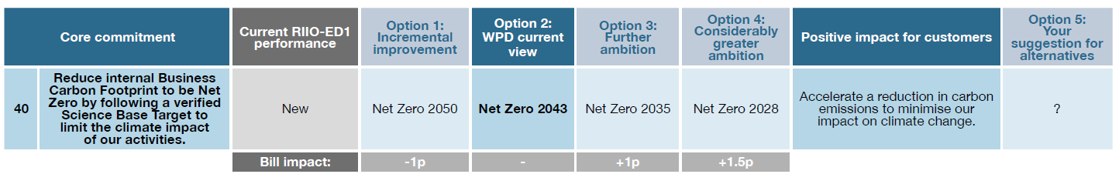
Headlines of our plan
Examples of our commitments
Within our consultation we are asking you to comment on options to alter the ambition of these outputs. E.g:

Slide 9
Questions we’d like you to answer
Core commitments
(see consultation document)
WPD’s first draft Business Plan
(see Business Plan)
Qu.
1-5
Qu.
6-13
For example:
Covering:
Question 4:
What option level would you prefer for each core commitment?
Option 1: Less than our current view (and at a lower cost).
Option 2: WPD’s current view
Option 3: Further ambition
Option 4: Considerably greater ambition
Presentation and accessibility of the Plan
Overall acceptability of the Plan
Delivering a low carbon future
westernpower.co.uk

Slide 10



What we’re asking you to do
www.westernpower.co.uk/RIIO-ED2-Business-Plan-Jan2021
Download and review our full Business Plan draft
If you’re time-pressed, review our consultation document (67 core commitments)
How to respond to this consultation
You can submit your responses to this consultation online.
If you want to respond only about WPD’s core commitments, you can use our online tool to provide feedback on each of the specific core commitments.
Alternatively you can download a response form and email or post this to us.
Visit:
www.westernpower.co.uk/RIIO-ED2-Business-Plan-Jan2021
Email:
yourpowerfuture@westernpower.co.uk
Write:
Stakeholder Team, Western Power Distribution, Herald Way, Castle Donington, DE74 2TU
Closing date: Sunday 28th February
westernpower.co.uk

Slide 11
Next steps
You have my absolute commitment that we will act on your feedback
We will publish a second draft Business Plan in March 2021
We will clearly set out the changes we have made as a result of your feedback
ANY QUESTIONS?
Thank you very much for time and input into our process
westernpower.co.uk

Slide 12
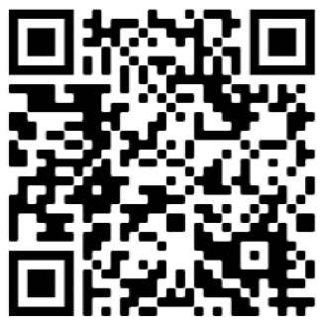
www.westernpower.co.uk/RIIO-ED2-Business-Plan-Jan2021

