Slide 1

Connection Customer Steering Group
20th June 2017

Slide 2
Connection Customer Steering Group
Welcome
Housekeeping
  No planned fire alarm test

Slide 3
Agenda
A stakeholder’s view of WPD
WPD Innovation
Matt Watson
Chief Executive’s Update
Summary, feedback and next steps
Robert Symons
Coffee
Lunch
Hugh Taylor - CEO Roadnight Taylor Ltd
Incentive on Connections Engagement Update
Alison Sleightholm
Network capacity and constraints information: update
Graham Halladay

Slide 4
A stakeholder’s view of WPD
Hugh Taylor - CEO
Roadnight Taylor Ltd
20th June 2017

Slide 5
Connections Overview
Robert Symons
Chief Executive
20th June 2017

Slide 6
Topics for discussion
Recent Developments
WPD 16/17 business plan delivery performance
Connections improvement plan 17/18
DSO transition update
UK general election

Slide 7
Business Plan performance update
The second year of RIIO-ED1 is complete 1st April 2016 – 31st March 2017
It is the second year of an eight year plan (to 2023)
We have committed to deliver 76 outputs in six areas
  Safety
  Customer Satisfaction
  Reliability
  Connections
  Environment
  Social Obligations
We are required to report to Ofgem our performance (‘RRP’ due end July) and to wider stakeholders (September)
We are now finalising our reporting. The following data gives an indication of our performance so far in the connections area

Slide 8
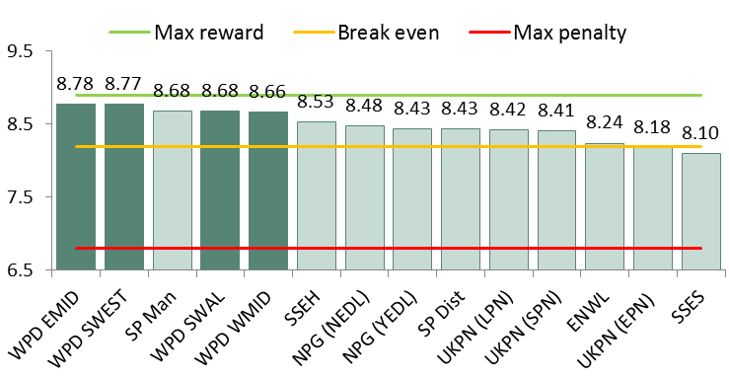
Connections
2015/16 performance:
34. | Time to connect | ✓
35. | Customer service | ✓
36. | Customer surveys - distributed generation | ✓
37. | Online project tracking | ✓
38. | Online information | ✓
39. | Connection surgeries | ✓
40. | Improving processes | ✓
41. | Guaranteed standards | ✓
42. | Raising awareness of competition | ✓
43. | Extending scope of contestable work | ✓
2016/17 performance:
Customer satisfaction
 | Time to Quote (average number of days) |  | Time to Connect (average number of days)
 | Single premises | 1-4 premises | Single premises | 1-4 premises
West Midlands | 4.51 | 6.09 | 36.24 | 49.86
East Midlands | 3.47 | 4.72 | 34.57 | 48.45
South Wales | 4.29 | 5.79 | 32.76 | 48.31
South West | 5.16 | 5.86 | 36.31 | 44.82
Ofgem target | 8.21 | 11.73 | 42.08 | 52.70
2015/16 key:
✓Achieved;
✓ On track, some areas to improve;
- Output under review
✗ Not met

Slide 9
Electricity distribution annual report
Ofgem have published the RIIO electricity distribution annual report 2015-16
The report summarises the performance of DNOs during the first year of ED1
The report is split into
  Outputs performance
  Expenditure performance
  Financial performance

Slide 10
Outputs performance
WPD perform well compared to other DNOs on the outputs comparison and are the stand-out performer for all customer service measures:
Measure | ENWL | NPg | WPD | UKPN | SPEN | SSE
Reliability
Environment
Fluid filled cables
Connections TTQ & TTC
Connections GSoP
Customer Satisfaction Survey
Customer Satisfaction Complaints
Customer Satisfaction Stakeholder engagement
Safety

Slide 11
Expenditure performance
Expenditure relative to allowance £m:
 | ENWL | NPg | WPD | UKPN | SPN | SSE | Total
2015-16 Allowance | 251 | 450 | 962 | 851 | 466 | 495 | 3,475
2015-16 Actual | 244 | 436 | 985 | 643 | 431 | 427 | 3,166
2015-16 Difference | -7 | -14 | 23 | -208 | -35 | -68 | -309
% | -3% | -3% | 2% | -24% | -8% | -14% | -9%

Slide 12
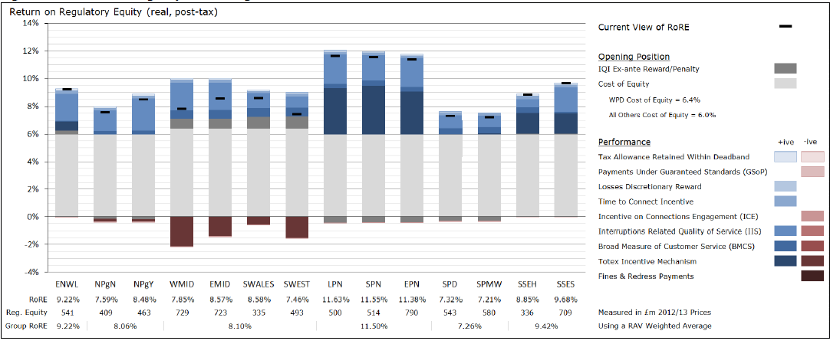
RORE performance
Forecast eight-year average RoRE

Slide 13
Ofgem Incentive on Connections Engagement (ICE)
Introduced by Ofgem under RIIO – ED1 with the aim to:
Replicate the effects of competition
Incentivise DNOs to improve the overall customer experience
Enable customers to influence a DNO’s high level strategy and work plan of activities
ICE requires DNOs to submit evidence that they have
  Engaged with a broad range of connections customers
  Responded to the needs of their customers
  Developed a forward-looking work plan to improve performance
  Set relevant performance indicators
  Reported actual performance against indicators and work plan
Our 17/18 plan is published on our website and Ofgem will be consulting on all the DNOs plans later this month
We welcome views on our plan at any time

Slide 14
What does our current ICE plan look like ?
Covers 10 key areas
  Actions to improve the information provided as part of the connections process
  Actions to improve customer service
  Actions to improve offers and agreements
  Actions to improve competition in connections
  Actions to improve the legal and consents process
  Actions to support connection of storage
  Actions to improve queue and capacity management
  Actions to support Community Energy
  Actions to improve forecasting and identify strategic reinforcement
  Actions to support the transition to DSO

Slide 15

How you can get involved
Our ICE plan is not set in tablets of stone and will be updated in line with customer feedback. There are plenty of opportunities to engage
Midlands UMS User Group
DG Owner Operator Forum
WPD Strategic Network Event
CCSG
Community Energy Workshops (2)
Community Energy Workshops (3)
Connection Surgeries
Managing European Solar Assets
Delivering a Smart Energy System
CCSG
APR ‘17
MAY ’17
JUN ‘17
JUL ‘17
AUG ‘17
SEP ‘17
OCT ‘17
NOV ’17
DEC ‘17
JAN ‘18
FEB ’18
MAR ‘18
Community Energy Workshop
ENA DG Forum
WPD Stakeholder Workshops (6)
Future Networks A Balancing Act
Community Energy Workshop
WPD DG Connections Workshop
DG Survey
WPD Strategic Network Event
Connection Surgeries
Community Energy Workshop
CCSG
CIC Workshop

Slide 16
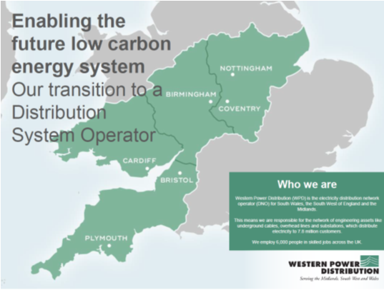
DSO strategy and transition plan
At the end of June WPD will publish a consultation on our plan for DSO transition
The consultation will set out
  Our view of what the future energy system will look like
  Our proposed strategy and actions for becoming a full DSO
  Why we believe DNOs are best placed to transition to regional DSOs
We will update the plan based on feedback and the BEIS/Ofgem smart system roadmap when published

Slide 17
UK General Election
The Conservative Manifesto promised a more interventionist approach to the energy market with a focus on affordable energy
  Lord Adair Turner is expected to head an independent review into the Cost of Energy
  Ofgem will be instructed to set an absolute tariff cap
  BEIS is likely to continue to develop its industrial strategy including the smart meter roll-out by 2020
  BEIS/Ofgem smart flexible energy response is so-say imminent
Failure to gain a majority, makes Mrs May’s BREXIT negotiations more difficult
The position on access to the Single Energy Market is unclear, as the UK is building interconnectors with Europe

Slide 18
QUESTIONS ?

Slide 19
ICE Update
Alison Sleightholm
Regulatory & Government Affairs Manager
20th June 2017
19

Slide 20

Ice Update
WPD Published our ICE Workplan at the end of April and submitted our ICE looking forward & looking back report to Ofgem and published on our website at the end of May.
This submission set out:
  Our stakeholder engagement strategy and approach explaining how this underpins the delivery of our connections strategy and development of our ICE workplans
  Looking back report
  Detailing the engagement activities we have undertaken and how these were used to develop initiatives in the year and those for the coming year
  Explaining the key initiatives we have delivered and our KPI performance
  Looking forward report
  The engagement activities we have planned
  Our improvement workplan plus how we used stakeholder input to develop it
  Our outputs and measures including the KPIs we have developed to track our connections performance

Slide 21
Looking back 2016/17- How did we do?
Workplan
In initial workplan started with 58 actions across 26 initiatives. This expanded throughout the year to 76 actions across 29 initiatives as new priorities emerged: e.g. the HV jointing ‘option 4’ trial.
We completed 72 actions (95%) with others due to be delivered or carried forward to 2017/18.
Actions carried forward include; QMEC £200/kW trial, outcomes of NGET SoW working group, expanding the issuing connection agreements earlier in the process and the full rollout of the HV self-connection ‘option 4’.
Key actions delivered against 2016/17 priorities identified

Slide 22
Looking back 2016/17
How did we do?
Engagement
We engaged over 7000 stakeholders via surveys (over 2400) and events (over 4700)
We expanded our use of online engagement through social media and the use of webinars and videos; e.g. our video guides on innovative connection arrangements had over 10,000 views in the first month online.
We created new engagement relationships through the implementation of the DG owner operator group and the senior manager contact for major customers.
Outputs & measures
We committed to 32 KPIs across 6 key areas, with 18 KPIs having improvement targets.
We achieved or exceeded 15 of the 18 targets
Of the 3 which fell short; of DG survey score was 8.74 vs. target ≥8.8 (still improving on last yr’s 8.52); our major customer survey score was 8.51 vs target >8.62; and 91% actions completed by their target date vs target 100% (95% of all actions were completed by year end).

Slide 23
ICE looking forward 2017/18 – updates to our approach
  Expanding engagement activities:
    Increasing engagement on the outcomes of actions – measuring the impact with stakeholders and identifying further improvements.
    Using topic-specific stakeholder forums / workshops improving focus of engagement, ensuring outputs deliver stakeholders’ requirements.
    Increasing use of online and social media – webinars, videos, live tweeting
  Initiatives and actions:
    Initiatives designed to address stakeholder feedback are supported by increased number of detailed specific actions
    Outputs and measures:
    Increased focus on the impact of an initiative on stakeholders, using their feedback to gauge success.
    Measures grouped to determine outcome of initiative rather than each detailed action, facilitating clearer view of success

Slide 24
ICE looking forward 2017/18 – workplan summary
  Workplan initiatives
  Improvement initiatives grouped into 10 focus areas and linked to the feedback driving them.
  Total of 44 improvement initiatives delivered by 147 specific actions.
  Increase in number of actions which are designed to collaborate, check back and assess the impact with stakeholders. E.g. development of customer forum for information provision
  Outputs & measures
  grouped by initiative and focused on the impact of the initiative on stakeholders to better measure success
    E.g. instead of measuring just the attendance at our DG forum we are measuring satisfaction.
  Increase from 32 to 60 KPIs this year with and increase from 18 to 36 improvement measures
  Focus areas
  Availability of information
  Customer service
  Connection offers & agreements
  Competition in connections
  Legals & consents
  Storage
  Queues & capacity management
  Community energy
  Strategic reinforcement & forecasting
  Distribution system operator

Slide 25
ICE Incentive Update: comparison with other DNOs
  Overview
  ICE workplans all have broadly similarly themed initiatives.
  Main differences is in the size and level of detailed actions
    SPEN and SSEN, have relatively small plans with high level initiatives
    WPD, UKPN and NPG have more detailed specific actions
    ENW have 3 separate work plans for CiC, DG and UM
    Our stakeholders have previously informed us they like the granularity of our workplan actions as they give a clear line of sight from their feedback to the output and make it easy to hold us to account

Slide 26
ICE Incentive Update: comparison with other DNOs (2)
Key initiatives not identified and included in WPD’s workplan or already implemented:
ENW
Trial ‘Training Needs Analysis’: to improve training services and planning with a view to quicker access to training for ICPs.
Improve visibility of audit performance: league tables of own contractors and ICPs.
Develop additional support for design submissions: design pack with standard HV templates.
Virtual Private Networks: develop proposals with stakeholders, supporting QMEC.
NPG
Publish schedule of rates for input services to ICPs so they can ‘pick & mix’ services.
Develop ‘low carbon connection gateway: website resource with information on different LCTs, how to apply and when to notify the DNO about their installation.
SP Energy Networks
Engagement: using alternative comms channels e.g. online tutorials on land rights and flexible connections
Telecoms: provision of cost estimate at deign stage and earlier visibility of actual costs post acceptance.
Telecoms: improved visibility of installation progress with monthly report on status and critical dates.

Slide 27
ICE Incentive Update: comparison with other DNOs (3)
Key initiatives not identified and included in WPD’s workplan or already implemented:
SSEN
Create customer charter of what customers can expect throughout connection stages and a detailed booklet of who’s who within the company, how teams fit together and contacts.
Hold discussion on programme of works post adoption agreement: between customer/ICP, DNO project manager and designer on dates, working together to meet connection dates.
Capacity and constraint information: Provide details of recent offers per BSP / GSP with split of costs by contestable, non-contestable and reinforcement.
Policy for streamlining metered highways small services: initiate new NERS accreditation for large unmetered and small metered connections self-POC and design.
Offer a ‘WebEx’ session with a Commercial Contract Manager, walking through the quote and answering any queries.
Information provision: hold workshops and WebEx sessions on specific topics: e.g. earthing, SoW, DUoS, Design self-determination.
UKPN
Introduce site information packs for housing and small commercial developments.
Provide live map of streetlighting faults.
Assess feasibility of providing ICP access to UKPN earthing tool.

Slide 28
ICE Incentive Update: comparison with other DNOs (4)
Reviewing other DNO’s plans
We will assess stakeholder demand and priorities before taking a view on whether WPD could undertake any of these initiatives in the current year, or wait to see whether the outturn of these initiatives has a significant benefit to customers
Are there any initiatives in the other DNO’s ICE work plans you believe WPD should be undertaking as a priority?

Slide 29
ICE Incentive Update: next steps
Ofgem to publish each DNO’s submission together with a consultation on whether or not we have met stakeholder’s expectations with our 2016/17 ICE activities and looking forward plans
  consultation is likely to be published in July and will inform Ofgem’s assessment of the submissions and their decision on whether DNOs have met the requirement of ICE, or whether a penalty should be applied.
WPD will continue to publish quarterly ICE workplan and KPI updates to enable stakeholders to track our progress
A resubmission of the ICE report in October will provide stakeholders and Ofgem a midpoint review of our ICE activities in 2017/18 including any new initiatives we are undertaking.

Slide 30
Coffee

Slide 31
Information on Capacity Available for Generation & Demand Customer
Graham Halladay
Network Services Manager

Slide 32
Information on Capacity Available for Generation & Demand Customer
ICE Plan:
Map based traffic light system of capacity for both Demand and Generation availability or constraint
Data Tables of capacity, reinforcement, costs, timescales
Facility for easier navigation

Slide 33
Information on Capacity Available for Generation & Demand Customer
Type | Capacity available | Thermal Constraints | Fault Level constraints | Transformer rating | Transformer loading | Alternative Offers Y/N | Average POC cost | Average reinforcement cost (WPD Network)
Demand | Red/Amber/Green | text description | text description | xx MVA | yy MVA | Available? Yes or No | Indicative POC cost £ | £ Ave Cost
Generation | Red/Amber/Green | text description | text description | xx MVA | yy MVA | Available? Yes or No |  | £ Ave Cost
Type | Upstream reinforcement | Indicative time scales for WPD connection work | SoW Information | Connected | Accepted | Offered | Available Capacity | Planned Reinforcement
Demand | Reinforcement higher in WPD system | mm Months | N/A | xx MW | xx MW | xx MW | xx MW | description
Generation | Reinforcement higher in WPD system | mm Months | Provide SoW Information | xx MW | xx MW | xx MW | xx MW | description

Slide 34
Information on Capacity Available for Generation & Demand Customer
Today:
Demonstrate an approach/tool for presenting/accessing
Your Feedback

Slide 35
Lunch

Slide 36
WPD Innovation
Matt Watson
Innovation & Low Carbon Networks Engineer

Slide 37










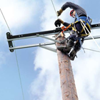


PLUGS AND SOCKETS
OPEN LV
NETWORK EQUILIBRIUM
SMART ENERGY ISLES
Future Networks Programme
Assets
Telemetry
Decision support
Improved assets
New assets
Flexibility
Automation
Incident response
Customers
New connections
Upgrades
Information
Self Serve
Products/Service
Tariffs
Communities
Operations
Reliability
Forecasting
DSO
DSR
GBSO Interface
Efficiency
SHE and Security
Network and Customer Data
Airborne Inspections
AIRSTART¹
Telecoms Analysis
Superconducting Cable
SF6 Alternatives
MVDC Test Lab
Smart Energy Laboratory
Statistical Ratings
Primary Network Power Quality Analysis
Hybrid Heat Pump Demonstration
Hydrogen Heat & Fleet
Carbon Tracing
HV Voltage Control
Solar Storage
LV Connect and Manage
Sunshine Tariff
CarConnect
Industrial & Commercial Storage
DSO/SO Shared Services
Project SYNC
Project ENTIRE
Smart Meter data for Network Operations
Distribution Operability Framework
Times Series Data Quality
Voltage Reduction Analysis
LV Connectivity
Smart Systems and Heat²
Note: 1 – Funded by Aerospace Technology Institution; Note 2 – Funded by the Energy Systems Catapult

Slide 38
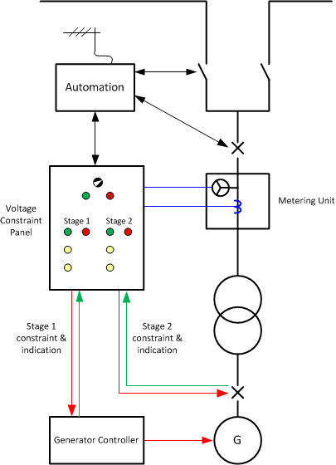
Alternative connections for demand
Through the development of the generator constraint panel and the ANM system in Alverdiscott/Indian Queens the interface has been modified for controllable demand connections.
This was extended to be able to control import and export on a single site, ideal for full control of batteries.

Slide 39
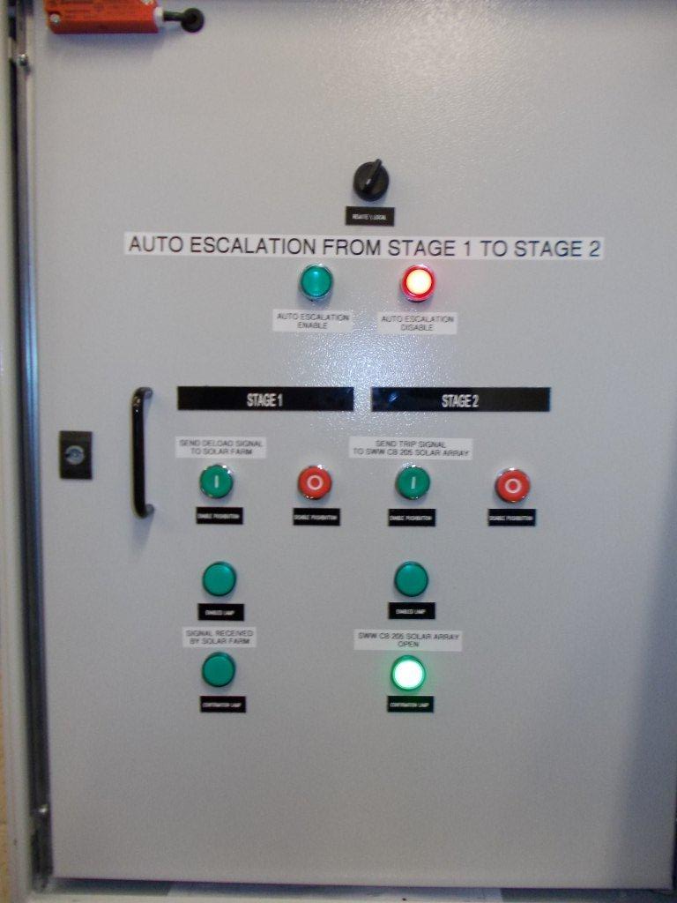
Alternative connections for demand
We are due to trial some controlled demand connections using similar infrastructure in the coming months
This will be in the form of a soft intertrip scheme
May be rolled out to full ANM schemes

Slide 40
Project Entire
Project Entire
A key DSR project following on from FALCON and SYNC
Focus on commercial mechanisms and revenue stacking
How to make DNO led DSR commercially viable
Interaction between DNO and SO led DSR
Understand scalability of DSR
Fits into wider DSO and active networks innovation
Looking for alternative solutions to 132kV reinforcement
4 year trial started in June 2016

Slide 41
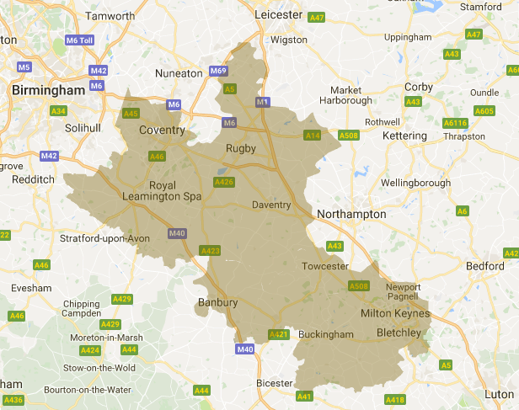
What we are doing?
Project Entire
Facilitating 5 WPD CMZ services
Developing managed service
Create customer sales capability
Developing technical systems and processes
Wider engagement in target area

Slide 42
Customer proposition

Slide 43
Customer Proposition
Creation of Flexible Power branding
Simplifying DSR programmes into single service
Customer engagement and recruitment
Increasing profile of DSR in target area
Revenue stacking from multiple programmes

Slide 44
Managed Service
Advanced control capability from new centralised facility
Continuous monitoring of assets with alerts and alarms
Agreed operating procedures taking away local resource burdens.
Customer has ultimate control of inhibiting dispatch
Simplifying DSR for customers
Asset optimisation
Self service statements and reports through customer portal

Slide 45
Services
CMZ service:
Week ahead notification of probable requirement
Arming fee assures of profit
Utilisation fee covers operating costs
Designed to integrate with other services
No deductions for service payments
Key driver behind the project

Slide 46
Services
STOR:
Initially working with STOR flexible services
De-rated capacity to maximise service quality and earnings
Majority of generated revenue passed through to participants
Simplified performance contracts
No annual performance reconciliations
Minimising negative impacts from group performance
De-rated performance targets to 95%

Slide 47
Services
Triad Avoidance:
TNUoS still valuable behind the meter
Not pursuing export benefits
Managed service, not warnings
Continuing successful record of avoidance from low response durations
Compatible with CMZ

Slide 48










Who are we targeting?
Half hourly metered customer in the target area
Ability to reduce demand or increase generation within 15 minutes of a signal and hold for at least 2 hours
We can offer Simple CMZ or full stacked service
Direct customers or through aggregators

Slide 49
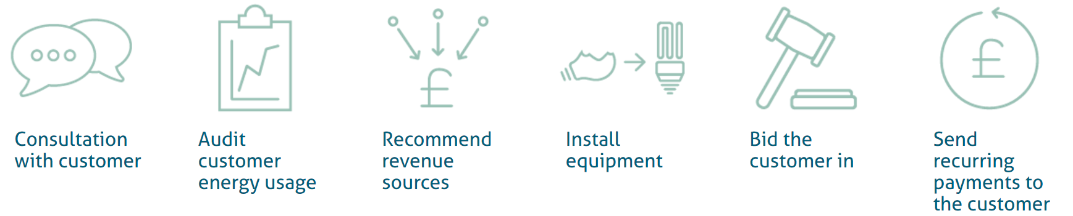
What’s the process?
Simple and easy to access
Ongoing admin via client app

Slide 50
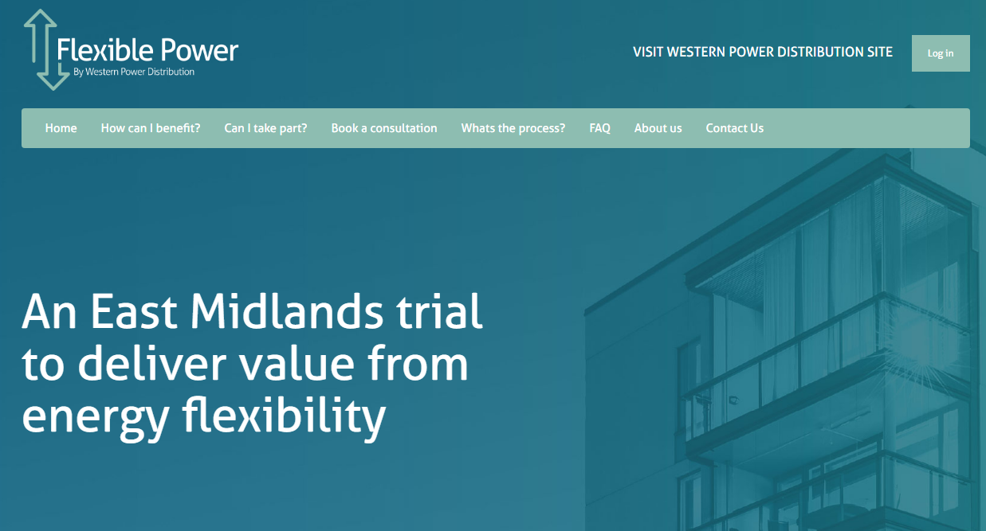
How to get involved
www.flexiblepower.co.uk
Wpdflexiblepower@westernpower.co.uk

Slide 51
WPD CCSG
Wrap up – Summary and Next Steps
Alison Sleightholm & Richard Allcock

Slide 52
Summary
  Issues and feedback captured from today

Slide 53
Next Steps
Ofgem ICE consultation – July
ICE Update submitted and published end of October
Dates for 2017 Workshops:
 | Potential CCSG breakout sessions:
24th Oct 2017 | Update on provision of outage information Update on legals & consents Process and service improvements

