Slide 1

Connection Customer Steering Group
21st February 2017

Slide 2
Connection Customer Steering Group
Welcome
Housekeeping
  No planned fire alarm test

Slide 3
Agenda
Chief Executive’s Update
Incentive on Connections Engagement Update
ICE Workplan 2017/18 outline
Strategic investment options for future networks scenarios
Summary, feedback and next steps
Nigel Turvey
Coffee
Lunch
Connections overview
CCSG feedback
Major connection customer WPD senior point of contact
Mark Shaw
Connection milestones
Tim Hughes

Slide 4
Connections Overview
Robert Symons
Chief Executive
21st February 2017

Slide 5
Topics for discussion
Recent Developments
Ofgem Smart Flexible Energy Consultation
National Grid Separation
ENA TSO/DSO project
DSO Transition Update

Slide 6

Smart Systems Call for Evidence
Recent Ofgem/Government call for evidence on the above highlighted the need to change including:
  Smart energy technology and processes have the potential to deliver lower bills
  Greater flexibility will help deliver security of supply
  Simpler integration of low carbon technologies
  Electrification of transport and heat will significantly impact the patterns and levels of power demand locally and nationally
  We should act sooner rather than later so consumers can benefit now

Slide 7
Smart Systems Call for Evidence
Ofgem’s identified immediate priorities for action now are:
  Increased coordination between distribution and transmission
  DNOs to transition to DSO with a review of progress in 2017
  The smart meter roll out
  Demand Side Response for Industrial and Commercial customers with work to establish why domestic DSR is so difficult even though it is necessary for success
  Storage with a focus on identifying and removing barriers

Slide 8
Smart Systems Call for Evidence
WPD response sets out why we believe the majority of flexibility will be embedded within the distribution network and why we are best placed to deliver as a DSO because:
  Proven track record of efficiency, network reliability and customer satisfaction
  Innovation strategy specifically focused on gaining the knowledge and experience in projects that can deliver flexibility as part of the transition from DNO to DSO
  Extensive ANM programme which has developed our capabilities in this area
Our strategic network investment work indicates that further benefits can be achieved where the DSO takes on an enhanced regional responsibility supporting the regional transmission network
Once responses are consolidated BEIS/Ofgem will issue a joint plan in late May/early June 2017
The Smart Energy Plan will comprise a series of work packages comprising both immediate actions and areas for further policy development

Slide 9
National Grid SO Separation
Ofgem is consulting on the SO role and its separation from the TO functions
The consultation envisages the SO will carry out its existing functions and take on some new ones so as to:
  Improve markets for balancing and ancillary services
  Promote competition and enable markets to innovate and drive efficient outcomes
  Promote economic and efficient whole system solutions, including smart solutions in place of traditional network investment
  Facilitate competition in networks
The consultation closes on 10th March. Ofgem aim to make the final decision on their policy approach to the roles of the SO by the summer
The target for actual separation is April 2019

Slide 10
ENA TSO-DSO Project
As of May 2016 there was approximately 28GW of distributed generation (DG) connected to the distribution network with the majority being connected within the last two years
Over 7GW is connected within WPD with a further 9GW in the pipeline
This has meant that Distribution Network Operators (DNOs), Transmission Owners (TOs), and the System Operator have had to respond and change the way they work together to maintain an economical and secure network

Slide 11
ENA TSO-DSO Project
In their call for evidence on a Smart Flexible Energy System BEIS and Ofgem emphasise the need for electricity network operators to make greater progress around T-D interactions
  Statement of Works process
  High voltage management
  Provision of shared services
  Active Network Management
  Charging
  Integrated approach to providing network capacity
In response to this challenge the Energy Networks Association has launched the TSO-DSO project to improve the customer experience across the boundary and look at whole system solutions

Slide 12
ENA TSO-DSO Project
ENA project launched with CEO commitment to deliver results in 2017
First phase to deliver in 2017
Second phase to deliver in 2018 and then beyond to ED2/T2
Objectives in 2017 are across 4 workstreams
  T - D processes
  Customer experience
Planning, connections, shared services and operation
How to improve the experience that customers currently receive
  DNO to DSO transition
  Charging
Develop a detailed view of the transition from DNO to DSO
Charging requirements on enduring T&D systems

Slide 13
ENA TSO-DSO Project
ENA are currently seeking feedback on any aspect of the project specifically
  What is important for you in planning the future of TD interface and DSO ?
  Is the focus of the project right ?
  Is there anything missing ?
  What involvement do you want ? What stakeholders should be involved in the advisory group ?
  How do you want to be kept up to date with progress (workshop, newsletters etc) ?

Slide 14
What are WPD doing ?
Transition from DNO to DSO
Alongside traditional reinforcement options, we need to:
  Make active use of new technologies, providers and solutions to help manage the distribution network
  Have an increased role in delivering ‘whole system’ solutions that are economic, efficient and coordinated
  Significantly increase engagement with National Grid (the GB System Operator) to deliver the best whole system outcome for customers

Slide 15
Our DSO priorities
Our DSO enabling priorities are to:
  Expand the existing roll out and application of Active Network Management (ANM) to the higher voltage networks, prioritising areas that are the most likely to benefit
  Protect the integrity and safety of lower voltage networks. We will be looking to maximise the use of smart meter data, apply additional network sensing as required and implement simple control schemes; and
  Co-ordinate with the SO by helping to establish visibility platforms for suppliers, aggregators and customers to allow the development of flexibility services shared between DSO and SO

Slide 16
Capabilities we need to develop
Transition to being a DSO is a substantial change, requiring many new capabilities
We have therefore developed a strategy, to address five key areas:
  Understanding historic and real time energy flows
  Forecasting future energy volumes across the network
  Actively reconfiguring the system dependent on need
  Commercial arrangements to contract services such as DG, active demand, storage
  Coordinating DSO operations with the National Grid (SO) and potentially providing services

Slide 17
Projects developing these capabilities
Active Network Management – developed from our Low Carbon Hub project
Long term strategic studies
Regional development programme being developed jointly with National Grid
Transmission – Distribution interface project via our trade association ENA
Demand response projects including FALCON, SYNC and ENTIRE
CarConnect Electric Nation – understanding customer behaviour when using static and dynamic time of use tariffs
Local Energy Market – development of a ‘visibility’ platform

Slide 18
Summary
The energy industry is going through a period of unprecedented change
To make sure our network is fit for purpose we have put in place a number of steps to meet the changing requirements
  Using our future networks programme to find innovative ways of operating the distribution network now and in the future
  Moving towards a smarter network where resources are actively controlled by having a clear plan towards DSO
  Analysis of current and future energy needs to identify areas for strategic network investment

Slide 19
QUESTIONS ?

Slide 20
Strategic Investment Studies
21st February 2017
Nigel Turvey – Network Strategy and Innovation Manager

Slide 21
Background
Significant usage of inherent capacity by connected and contracted generation
Due to both cost and timescales for reinforcement, alternative connection arrangements or connections elsewhere increasingly preferred by generation
Both distribution reinforcement requirements and Statement of Works (SoW) process have caused uncertainty and difficulties for generation customers to commit investment in their projects
Whilst volumes of applications for large scale connections have fallen the cost of the technology continues to go down and, excluding significant grid reinforcement costs, price parity for large (>10MW) solar could be reached by 2020

Slide 22
Committee on Climate Change report June 2016
Whilst sufficient progress (in low carbon generation) has been made to meet the committees indicators for 2020,
  ‘longer term development of low carbon capacity is at risk and not consistent with achieving carbon intensity below 100gCO2/kWh by 2030’
  ‘To reduce emissions at lowest cost, policy should provide a route to market for onshore wind and solar, ensuring that cost effective projects are able to compete fairly with other technologies and obtain long-term contracts at a price that implies no additional subsidy’

Slide 23
Objectives
Forecast growth of demand and generation over four economic and environmental scenarios
Assess the thermal and voltage constraints under these scenarios that will limit the ability of new demand and generation connections to take place
Assess options for reinforcement
Provide stakeholders with advance notice of likely constraints; and
Provide recommendations for ‘low regret’ investment

Slide 24
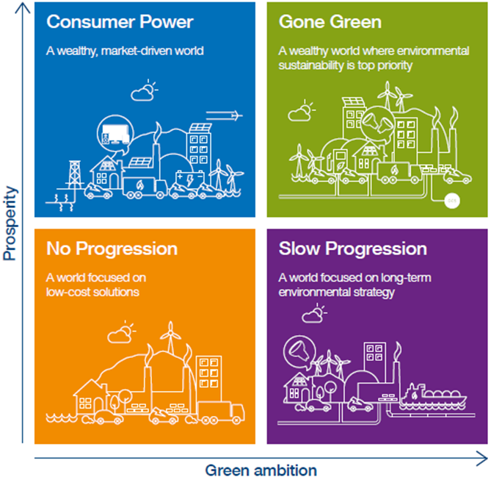
Scenarios
  Forecast by Regen SW from 2015 to 2030
Growth of:
  Distributed generation (DG)
  Heat pumps (HPs)
  Electric vehicles (EVs)
  Battery storage
Four scenarios corresponding to NGT FES:
  Gone Green
  Consumer Power
  Slow Progression
  No Progression

Slide 25
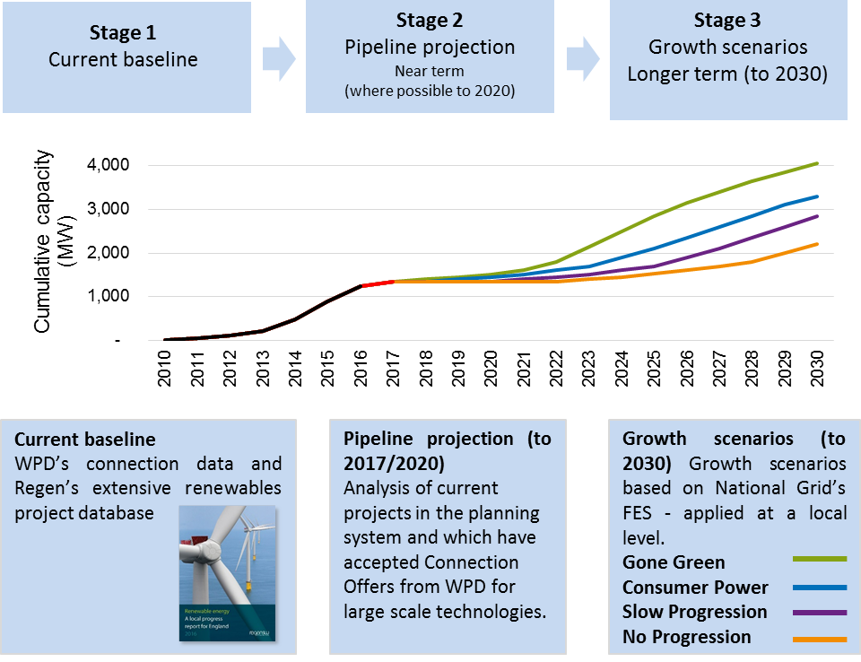
Scenarios – methodology for DG

Slide 26
Scenarios – methodology for Demand
Not a significant issue in S West or S Wales as a general underlying growth appears is largely offset by improved efficiency and hence most growth is associated with LCT’s (e.g. EVs)
In East Midlands there are significant industrial/commercial development areas and analysis of local plans has informed the demand forecast used

Slide 27
Network modelling
Focus on the subtransmission network consisting of:
  GSPs (400 or 275kV to 132, 66 or 33kV)
  132kV network
  BSPs (132/66kV, 132/33kV and 132/11kV in South Wales)
  66kV network
  66/11kV primary substations
Subtransmission reinforcement often protracted and expensive; requires long-term planning

Slide 28
Network modelling
Previous analysis has focused on the expected peak/minimum demand conditions. This study modelled each half-hour for:
  Summer day (DG dominated)
  Winter day (demand dominated)
  Typical spring/autumn day
Intact network, first-circuit outages, second-circuit outages and busbar outages analysed
Profiles of generation/demand were determined using a combination of historic data logging data modified for technology additions according to the scenario
Network automation such as intertripping and overload management was modelled
Analysis was undertaken for the baseline of 2016 and then the scenarios for 2020 and 2025

Slide 29
Progress/timetable
S West – completed, published and webinar held
S Wales – completed published and webinar organised for 24th Feb
E Midlands – Scenarios developed, workshop held but further consultation on demand needed
W Midlands – Due to start mid 2017 with completion by year end
In addition we are progressing work to produce some generic models for storage operation that we can use in the modelling work – intention is to consult on this in the summer/autumn 2017

Slide 30
Interface with NGET
As highlighted by the Statement of Works/modification application process, we have also reached the limit of the transmission system in a number of locations
To understand the transmission issues that would arise under the scenarios we have improved the exchange of network data between WPD and NGET including trialling a revised Statement of Works process.
WPD is currently working with National Grid to develop a Regional Development Programme

Slide 31
Regional Development Program
We are working with National Grid SO on a Regional Development Plan for the South West
The aim of this plan is to redefine network limits to release capacity by:
  Developing enhanced network data and models
  Improved Distributed Energy Resource (DER) control, and
  The implementation of enhanced operability schemes.
This will include developing a process to allow efficient decision making between transmission, distribution or service solutions that cater for the capacity limits expected when applying our long term scenarios in the growth of Distributed Generation (DG) and demand

Slide 32
Other issues to address
Abnormal operating conditions – whilst our connection agreements are clear that we have the right to constrain generation under abnormal operating conditions, it is not possible to accurately define the risk that this imposes on a generator.
Better defining commercial rights and hence conditions for compensation is likely to be the best long term way to address this – being progressed via ENA TSO-DSO project
P2 review
Distribution System Operability Framework – some of the issues highlighted while undertaking this study will be incorporated into a D SOF currently being worked on
System Operability Framework produced by NGET may evolve into a ‘whole system’ SOF

Slide 33
Distribution System Operability Framework
In development. We are planning to split into 3 sections (with some examples of content below):
Networks | Performance | Customers
Network modelling What further modelling capability needs to be added? | Arc Suppression Coils At what point will ASC earthing in Cornwall need to be replaced? | Power Quality How will new technology types and demand growth affect our power quality?
Network monitoring What additional monitoring of the network is required? | Fault Levels What are the effects of rising and falling fault levels on our network? | Dispatch Coordination Between DNO/DSO and SO, suppliers and customers for demand/generation dispatch or curtailment?
Active Network Management What are the limitations of current and proposed ANM systems used by WPD and NGET? | Low Frequency Demand Disconnection To what extent are generation dominated networks degrading LFDD? | Customer Demand Profiles How will changing customer demand profiles affect how we design and operate our network?

Slide 34
Summary
Start of a process that:
  Will inform stakeholders of potential constraints on the network
  Provide the input to understanding opportunities for flexible resources
  Provide the input to understanding future operability issues

Slide 35
Major Customer Senior Point of Contact
CCSG – 21st February 2017
Mark Shaw
Network Services Manager
West Midlands

Slide 36
Background
Feedback from major customers indicated that they would like a senior point of contact in WPD for escalation purposes.
Initially we identified 50 major customers and made the decision to utilise DMs and NSMs as the point of contact.

Slide 37
Role of the Senior Manager Point of Contact
Liaise with the customer to understand the range and scope of works they propose to undertake with WPD
Act as a senior escalation point of contact to either resolve issues or get the most appropriate person in WPD to contact that customer in order to resolve the issue.
Leave day to day operational interaction with the teams

Slide 38
Progress to Date
We have Senior Points of Contacts for 61 of our Major Customers
Each Senior Manager has contacted their customer to introduce the role and ensure the customer has their contact details.
To date the Senior Points of Contacts are being utilised by some of our Major Customers.

Slide 39
General Feedback from our Customers(1)
Our major customers believe that the Senior Points of Contacts initiative is a good one.
Generally our major customers do not require regular review meetings.
Customers are content that should they need to escalate an issue they can pick up the phone to their Senior Point of Contact.

Slide 40
General Feedback from our Customers(2)
The Senior Points of Contacts have been used to resolve issues which the customer could not resolve directly with the teams.
The Senior Point of Contact has been contacted to assist with consistency of operation across the WPD area.

Slide 41
Questions & Feedback?

Slide 42
Coffee

Slide 43

Connection milestones and offer letter update
21st February 2017
Tim Hughes – Connection Policy Manager

Slide 44
Connection Offer update
  Background
  We are undertaking a comprehensive review of our connections offer letter and general terms & conditions.
  Using feedback from staff and customers, we have worked closely with our solicitors, to ensure the new DG offers are presented in a clear and consistent way
  We have rolled out training to staff to ensure consistency and to provide a refresher on the importance of the contractual arrangements provided by the offer
  We are commencing with the DG dual offer letter and will then rollout further templates for other connection categories

Slide 45
Connection Offer update
  Revised DG dual offer letter: summary of changes
  Clarifying amendments: revisions mostly clarify rather than alter the existing contractual position e.g. definitions in General Conditions (GCs) expanded to clarify the meaning of certain terms used throughout the Connection Offer
  Offer and Acceptance: process amended to clarify when parties are contractually bound to each other. New acceptance form signed and dated by WPD when received
  Statement of Works: sets out greater detail on SOW process, implications and potential consequences
  Network Constraints and De-energisation: explains in greater detail WPD's existing rights to constrain or de-energise the connection. Brings it in line with the provisions contained in the Connection Agreement.

Slide 46
Connection Offer update
  Revised DG dual offer letter: summary of changes
  Deemed variation: e.g. where milestones have not been met WPD may terminate or will vary the agreement
  Property Matters: provides greater detail on the obligations on the Customer to procure and demonstrate that it has in place all of the land rights necessary for the Connection Works and consequences for failure to put in place and maintain them
  Third party payments: wording reinforces the contractual position concerning payments made under the Connection Offer to WPD by a third party on behalf of the Customer
  Automatic Termination: removed automatic termination. Termination events require the party to serve notice on the other.

Slide 47
Connection Offer update
  Connection milestones background
  WPD implemented offer letter milestones a number of years ago for DG schemes to support fair allocation of network capacity and limit the effect of slow moving schemes on other connectees
  Ofgem’s Quicker & more Efficient Connections initiative brought the connections ‘bottleneck’ in to focus and so we introduced new policy and guidance on our approach to slow moving schemes
  The ENA DG/DNO Steering Group has developed a best practice guide following consultation with wider stakeholder groups.
  We are planning to make changes to the WPD offer letter milestones as a result of this guidance and our own experience of managing slow moving schemes.

Slide 48

Connection Offer update
  ENA best practice guidance
  Sets out high level principles to underpin the milestones. These include:
    Early milestones enforced more rigidly
    Once milestone elapsed, DNOs will request evidence and discuss.
    Customer needs to demonstrate progress or that lack of progress no fault of their own
    Offer will terminate if satisfactory evidence not received
    Planning milestones vary according to whether an EIA is required
    DNOs may choose to apply less than all of the milestones above to certain categories of projects.

Slide 49
Connection Offer update
  WPD adoption of best practice
  We plan to amend our Connection Offers to add two further milestones adopting the following elements of the best practice document:
  • Initiate planning permission
  • Land rights
Initiate Planning |  |  | Land Rights | Secure Planning |  | Commence & Progress Works | Project Construction
No EIA | With EIA |  |  | No EIA | With EIA
Submit a valid planning application | Evidence work on EIA has been initiated | Submit a valid planning application
2 months from Offer acceptance | 2 months from Offer acceptance | 14 months from Offer accpetance | 2 months from Offer acceptance | 12 months from Offer acceptance | 24 months from Offer acceptance | 6 months from obtaining planning | 12 months from commencing the works

Slide 50
Connection offer update
  WPD adoption of best practice
  Key will be how we interpret evidence, e.g. under ‘Land Rights’ the Customer can provide evidence to WPD’s reasonable satisfaction to demonstrate that it:
  i) is an owner or lessee of the land on which the Customer’s Installation is situated; or
  ii) has entered into an agreement to lease the land on which the Customer’s Installation is situated; or
  iii) has an option to purchase or to lease the land on which the Customer’s Installation is situated
  We will look to extend best practice in to Demand type Connection Offers
  We will be communicating these changes out to customers with a guidance note explaining the key changes

Slide 51
Lunch

Slide 52
ICE Update
Alison Sleightholm
Regulatory & Government Affairs Manager
21st February 2017
52

Slide 53
ICE Update
  2016/17 ICE Workplan actions are progressing, update published on WPD website with action status and progress, together with KPI update.
  We are in the process of drafting the actions for our 2017/18 Workplan following the assessment of stakeholder feedback on the priorities for WPD to address.
  ICE timetable:
ICE submission (looking fwd & back)
Ofgem consultation
ICE Workplan publication
Resubmission
Apr ‘17
May ‘17
Jul ‘17
Oct ‘17

Slide 54
Connection engagement
  We have a range of connection stakeholder engagement activities planned throughout the year which will continue our communication and feedback opportunities, feeding into our ICE development
Connection Surgeries
Solar & Storage Birmingham
3-4 October
LCNI
ICP/IDNO Workshop
Midlands UMS User Group
CCSG Workshop
CCSG Workshop
Connection Surgeries
APR ‘17
MAY ’17
JUN ‘17
JUL ‘17
AUG ‘17
SEP ‘17
OCT ‘17
NOV ’17
DEC ‘17
JAN ‘18
FEB ’18
MAR ‘18
DG Survey
WPD DG Connections Workshop
CCSG Workshop
W.Mids Strategic Network Investment Stakeholder Event
E.Mids Strategic Network Investment Results Webinar
Connection Surgeries
S.West Strategic Network Investment Stakeholder Event
ENA DG Forum
WPD Stakeholder Workshops x 6
South Wales UMS User Group
Community Energy Workshops (x4)
Firm
Provisional

Slide 55
2017/18 ICE Workplan
  Workplan development
  At the Oct ‘16 CCSG we took on-board your feedback on the priorities we had identified through our stakeholder feedback
  We also sought feedback at the WPD stakeholder workshops in Jan’17
  Using the priorities and specific feedback we have developed our draft Workplan initiatives and the actions required to deliver the required improvements.
  We are seeking CCSG member’s views on the ICE workplan initiatives and actions to ensure we are undertaking the appropriate improvements

Slide 56
2017/18 ICE Workplan
  Priorities
From the feedback in our engagement activity up to now and with the CCSG’s input we have refined the priority areas to address:
Availability of information: further improve information on outages, SoW, work programmes, constraint & capacity info including demand and storage
Consistency: continue to improve consistency in service and application of policy across WPD areas/teams including SoW, design approval, pre-connection info
Competition in Connections: refine processes to make improvements to Competition in Connection Code of Practice activities including HV self-connection and design approval
Transition to DSO: develop policies, processes and technology facilitating move to DSO. Engage with stakeholders on the development of the DSO role

Slide 57
2017/18 ICE Workplan
  Initiatives
  Availability of information
    Develop and implement actions arising from the WPD generator owner forum to improve the notification of outages and constraints for connected and prospective customers
      Explore interest in in 'consortium' approach to outages affecting multiple generation sites
      Extend portal functionality to include the ability for 11kV generation details to be updated
      Improve on historic outage data available on website and provide access to potential customers
      Provide maintenance frequency overview on typical items of electricity distribution plant and discuss case studies of 'outages in practice‘
      Present to forum on power factor and its impact on networks
    Continue to improve the SoW process and the information provided to customers at each stage from pre-application to connection.
    Make further improvements to the mapping information provided by WPD: Develop a map based traffic light system to inform customers of where capacity for both demand and generation is either available or constrained (including thermal, fault level, reinforcement cost)
      Gauge interest in a customer forum to steer these developments and outputs.

Slide 58
2017/18 ICE Workplan
  Initiatives
  Service provided post-acceptance
    Identify and develop further improvements in the communication and information provided to customers, post acceptance on their connection scheme work programme and progress
    Use feedback from senior management point of contacts and CCSG to develop actions for service improvement.
  Consistency of process and policy
    Continue to identify areas of inconsistency in either policies, application of policy and procedure (e.g. CiC design approval)
    Engage with ICPs / IDNOs with survey to prompt for areas of inconsistency, reviewing feedback and taking action as necessary.
    Hold ICP / IDNO stakeholder event to obtain feedback on and communicate developments being made to processes and procedures

Slide 59
2017/18 ICE Workplan
  Initiatives
  Competition In Connections
    Improve the processes and consistency in approach for design approval
    Meet with stakeholders to obtain feedback on their experiences and review our processes
    Share proposed changes with stakeholders and implement changes as required.
    Continue trial of new HV self-connect procedures
    Use feedback to make refinements as necessary, before rolling out as BAU
    Support the new process being put through the CiC CoP change proposals procedure as appropriate.
  Legals and consents
    Continue improvements to the Legals and consents process using stakeholder feedback and analysis of performance monitoring data
    offer guidance on our preferred approach for when to use a wayleave or an easement for HV and EHV works
    improve the transparency of the legal and consents process for customers by enabling them to access project specific information via the online applications system CIRT

Slide 60
2017/18 ICE Workplan
  Initiatives
  Storage
    Provide guidance on the connection of energy storage schemes
    Produce policy to define information requirements and application process
  Queues & Capacity Management
    Review and implement changes to the WPD rules for allowable changes in connection applications and post acceptance, in line with outputs from the national DG DNO working group as required.
  Strategic Reinforcement & Forecasting
    Continue with Strategic network studies engaging with stakeholders on generation and demand forecasts, scenarios and outcomes.
  Connection Offers & Agreements
    implement A&D fees inline with legislation amendments and industry guidance by implementation date.
    Implement new policy and procedures to facilitate the changes to the ECCRs include the move from 5 to 10 yrs and the payments to customers on assets adopted under CiC.

Slide 61
2017/18 ICE Workplan
  Initiatives
  Community Energy
    Provide information which is relevant to CE stakeholders making sure that it is simple to understand and accessible.
    Provide a dedicated community energy page on the WPD website covering latest events, publications, videos, podcasts and content.
    Facilitate regular CE events bringing people face-to-face or presenting innovation projects in a way that inspires ideas works best for these stakeholders.
  DSO
    Continue engagement with stakeholders on the development of the role of the DSO as well as undertaking new developments in policy, process and technology which will facilitate the move to DSO.
    Publish a WPD DSO strategy document
    Continue to develop and raise awareness of trials on demand side response, flexibility services for DSO and SO.

Slide 62
2017/18 ICE Workplan
  Feedback
  Have we correctly identified the initiatives which address the connections priorities for 2017/18?
    If not what other initiatives do you believe we need to be looking at?
  Are there any specific actions you would like to see us undertake?
  Which area(s) do you think should have the highest priority / are most important?

Slide 63
2017/18 ICE Workplan
  Next steps
We will use your feedback to make further refinements and capture any additional actions ahead of finalising the ICE Workplan for publication in April ‘17.

Slide 64
WPD CCSG
Wrap up – Summary and Next Steps
Alison Sleightholm & Richard Allcock

Slide 65
Summary
  Issues and feedback captured from today

Slide 66
Next Steps
ICE Update submitted and published end of October
Dates for 2017 Workshops:
 | Potential CCSG breakout sessions:
20th Jun 2017 | Innovation projects Network information (capacity maps etc.) Update on provision of outage information Update on legals & consents Process and service improvements DSO developments
24th Oct 2017

