Slide 1

Resilience of small / medium businesses:
Stakeholder workshop
April 2015

Slide 2
Agenda
A quick overview of WPD
Three morning sessions following a similar format:
  WPD presentation
  Round-table discussion
  Session 1: Understanding vulnerability for small / medium businesses
  Session 2: Developing an action plan with respect to:
  a) Low customer awareness
  b) Reliability and resilience
  Session 3: Developing and action plan with respect to:
  a) New connections
  b) Street-works
2

Slide 3


Electricity Networks
A short introductory video to explain how electricity networks operate
3

Slide 4
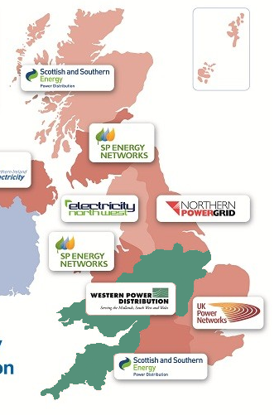
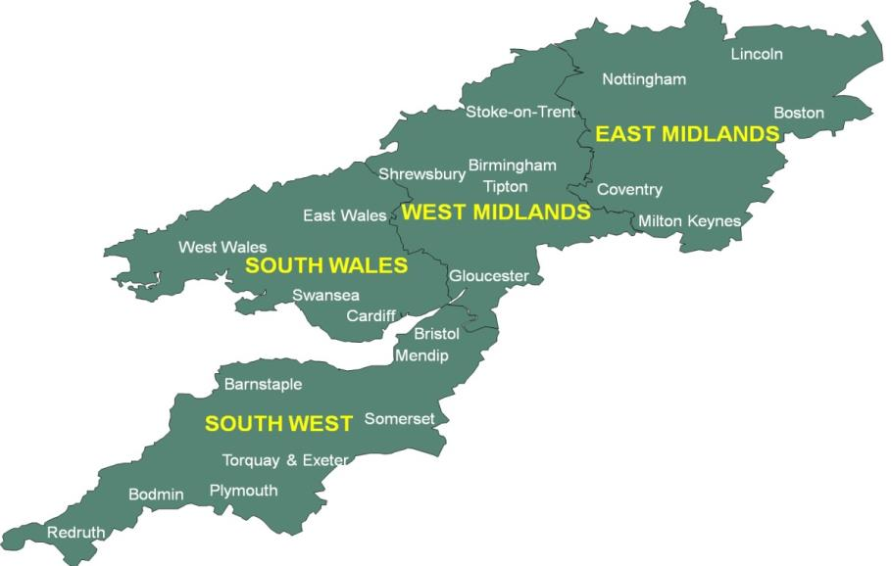
UK electricity distribution areas
14 Distribution Network Operators (“DNOs”) in the U.K - WPD owns four of them
We operate the electricity network of poles, pylons, cables, wires and substations
We are not a supplier
7.8 million homes and businesses rely on us every day
4

Slide 5

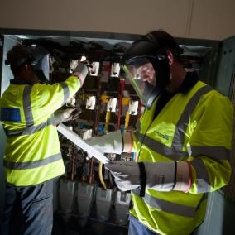
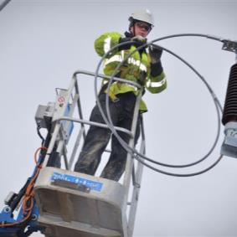
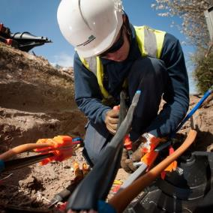
What we do comprises 4 key tasks
1. Keep the lights on
by operating our network assets effectively
2. Maintain equipment
so it is in a condition to remain reliable
3. Repair equipment
if it gets damaged or if it is faulty
4. Upgrade the network & connect new customers
to provide additional electricity supplies or capacity to our customers
Continual focus on achieving the highest standards of safety
5

Slide 6


The Business Plan process
We are a regulated monopoly
Ofgem issues licences setting out our obligations and responsibilities
Periodically, Ofgem scrutinises the Business Plans of DNOs in a process called a ‘Distribution Price Control Review’
The current process is called ‘RIIO-ED1’ and covers the period 2015-2023
6

Slide 7
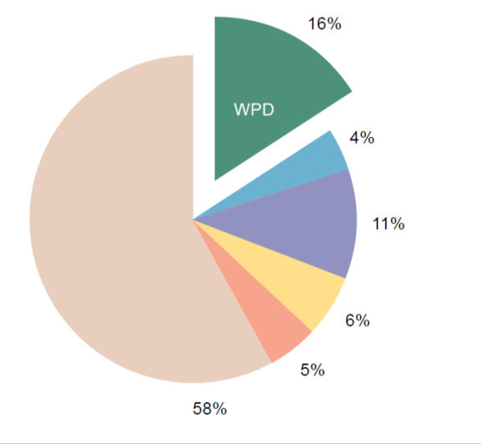
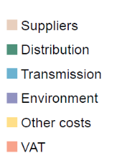
WPD’s expenditure and how this impacts the customer bill
Of an average annual electricity bill, WPD’s distribution charges are:
Domestic: c.£100 a year
Small businesses: c.£310 a year (£246-£380)
Medium businesses: c.£2,100 a year (£1759-£2408)
WPD’s revenues are fixed for the next 8 years
Make-up of the customer bill

Slide 8
WPD’s Business Plan
Our Business Plan is huge
  We will invest £6.3bn in core distribution activities
We will improve service in every area
  And remain number one for customer service and network performance
We will remain the most efficient
  We have saved £119m per year since acquiring the Midlands in 2011, and will save a further £260m in the next 8 years
8

Slide 9
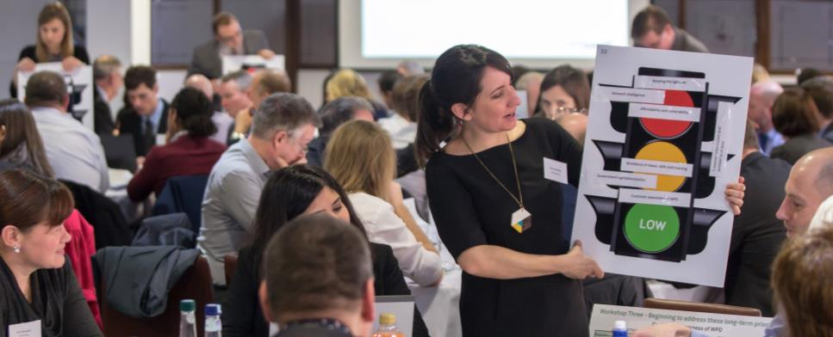
Why we engage with stakeholders
We have a strong track record of engaging with stakeholders – 4,500 have had their say on our Business Plan in the last 3 years
We engage to:
  Understand your priorities
  Identify actions to improve
  Work with stakeholders to deliver effectively
Specific engagement with key groups – e.g. connections, vulnerable customers, major energy users, Areas of Outstanding Natural Beauty etc
Up to now we haven’t engaged specifically with small and medium businesses
9

Slide 10
Session 1:
Understanding ‘vulnerability’ for
small / medium businesses
Alex Wilkes
Stakeholder Engagement Manager

Slide 11


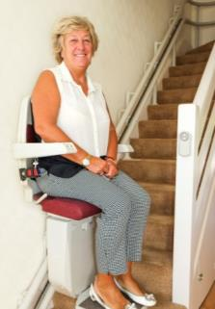
What does ‘vulnerability’ traditionally mean for WPD?
Domestic customer focussed
Until recently - customers permanently vulnerable not just in vulnerable circumstances
We have and update a ‘Priority Service Register’:
  Focus on power cuts
  Resilience advice/planning in advance
  Practical assistance and information during
Medically dependent on electricity | Pensionable age | Chronically sick | Communication needs (e.g. blind or deaf) | Wider vulnerability (e.g. restricted movement, stair lift user etc)

Slide 12
“Anyone can be vulnerable”
  The nature of WPD’s activities…
  Power cuts Connections Maintenance General enquiries
  Vehicles Streetworks Large and visible infrastructure
  …mean we have a big impact on customers of all types
Its not just when things go “wrong” (e.g. multiple power cuts) but the impact of day-to-day work (e.g. planned maintenance of the network)
This session:
How resilient are you and what are the key factors that impact you?

Slide 13
Understanding vulnerability
Within our network area, we have:
  466,387 small businesses
  201,038 medium businesses
These vary across a range of sectors and industries
Some stakeholders have told us that relatively few small/medium businesses consider developing a resilience plan
  But the impact can be disproportionately large if supply is interrupted
This is why they could be categorised as ‘vulnerable’

Slide 14

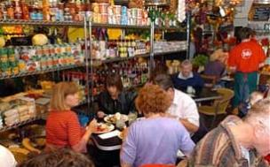

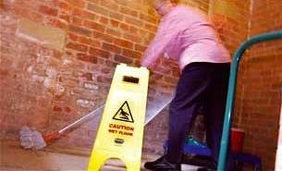
An example – Small businesses
  Our recent workshops highlighted that small and medium businesses also feel vulnerable to certain circumstances
  In a recent Utility Week article, the Chairman of the Federation of Small Businesses stated:
  “How resilient small businesses are to extreme weather… [is] one of the key, unanswered questions raised by government”
  “FSB research shows that 66% of small businesses have been negatively
  affected by extreme weather in the past three years”
  “As a result of disruption to transport and utility infrastructure, many small businesses suffered from the indirect impacts on their operations and staff, with many reporting a drop in customer numbers”
  “However, our most recent research suggests
  60% of small businesses still have no resilience plan in place”

Slide 15
“Anyone can be vulnerable”
It is therefore important to us that we understand:
  The impact of our operations on you.
  The different ways in which wider customers are vulnerable, and when.
  What we can do to address this.
  There are seemingly two key aspects for us to consider:
Minimising the disruption caused by our operations in the first place
Helping to improve self-resilience
  “How we can identify and address vulnerabilities in our infrastructure / network”
  “How we can help businesses to help themselves to minimise the impact of extreme weather”

Slide 16
Some of the factors you may wish to consider
A few examples:
Power Cuts
Low Customer Awareness
Connections
Street works
Quality of supply
DUoS* charges
Staff down time
Not knowing who to talk to
Speed of process
Timing/ scheduling of work
Dips and voltage fluctuations
Advanced notice
Availability of information
Not having WPD contact details
Cost / availability of capacity
Amount of notice
Disruption (to operations)
Lost production time (=lost profit)
Lost time / productivity
Access issues
Sensitivity of equipment
Inability to plan
Disruption to you / customers
Lost production time (=lost profit)
* “DUoS” = Distribution Use of System Charges

Slide 17
Workshop 1 – Discussion questions
Do you consider your business / your members’ businesses to be vulnerable?
Does your business / your members’ businesses have a resilience plan in place? How resilient is your business / your members’ businesses?
What are the key factors impacting the resilience/vulnerability of small/medium businesses?
Do you think Small/Medium businesses should engage with WPD and why?
17

Slide 18
Session 2:
  Developing a WPD action plan with respect to:
    Low customer awareness
    Reliability and resilience
Alison Sleightholm
Regulatory & Government Affairs Manager

Slide 19
This session
Customer awareness
  WPD’s approach
  Why we think its important to you
Reliability and Resilience
  Unplanned power cuts – WPD’s approach
  Planned power cuts – WPD’s approach
  Quality of supply – WPD’s approach
  Why we think its important to you

Slide 20


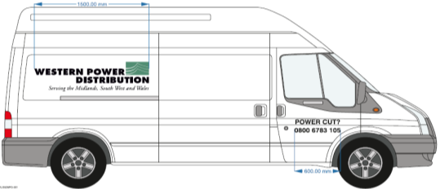
Customer awareness of WPD
– Our approach
For many years we’ve been working to increase awareness:
Since 2010 we’ve written directly to every customer via our ‘Power for Life’ publication
Annual radio, newspaper and television advertising
Single emergency contact telephone number:
  Fridge magnet sent to every WPD customer (7.8m)
  Supported by radio advertising campaign
  Now displayed on every WPD vehicle
Power For Life
March 2014
Fridge magnet mailing (Nov 2014)
  37%
  47%
  57%
20

Slide 21
Customer awareness of WPD
- Why we think its important for you
Why we think you need to know about us:
Knowing who to contact during an emergency
  Quicker access to information
  Aid decision making and avoid indecision/uncertainty – e.g. whether to shut or not
Resilience to severe weather
  Being better prepared – knowing the full impact in advance
  Taking steps to mitigate the disruption and possible contingencies
  The relationships WPD have with customers are changing
  E.g. demand side response; low carbon technologies; smart meters / networks
  Increased visibility of WPD
  Delivering our Business Plan will involve planned work programmes across our regions, potentially increasing WPD’s visibility (e.g. street works)

Slide 22
Customer awareness of WPD
- How can we help?
Knowing who to contact during an emergency
  Quicker access to information
  Aid decision making – e.g. whether to shut or not
We can help you to be better prepared
  Understand why its important to know about WPD
  Understand what you should to do during an emergency
  Robust contingency plans
  Understanding your vulnerable sites
  Contacting the right person at WPD
  Temporary generation

Slide 23
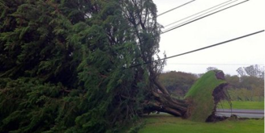
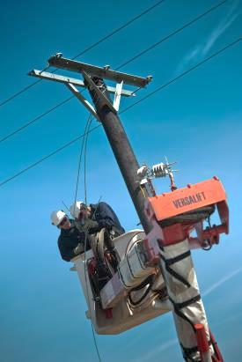
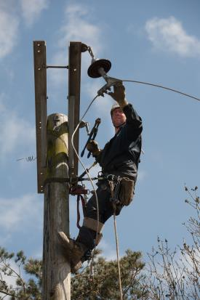
Unplanned power cuts
- Our approach
Unfortunately power cuts are inevitable
  Severe weather, aging equipment, third party damage
WPD are investing significantly to keep power cuts to a minimum
  Replacing aging equipment, tree trimming programmes, flood protection schemes etc
  Our business plan includes £2.2bn on network investment
  We have committed to deliver 13% fewer power cuts and 20% quicker restorations
On average customers experience approximately:
  One power cut every 18 months
  c.90% of power cuts restored within 1hour*
Uprooted tree in power lines, South West
23
* on the high voltage network

Slide 24
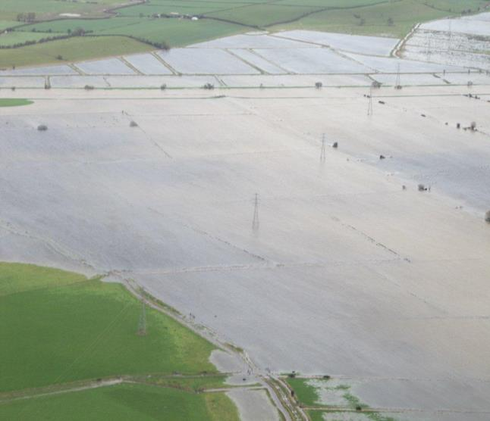
Unplanned power cuts
- Storms 2013/14
Christmas 2013 – storms caused major disruption across the UK
  Almost 1 million customer lost their electricity supply
In parts of the UK 16,000 were without power over 48hrs – some for 6 days
WPD’s performance – 23rd-28th Dec 2013
Restored 133,790 customers over the period: 86.10% customers restored within 3 hours 99.99% customers restored within 24 hours 24,551 in-bound customer calls Average speed of answer of 1.6 seconds Over 15,000 text messages proactively sent to customers Zero Guaranteed Standards failures
24
* on the high voltage network

Slide 25

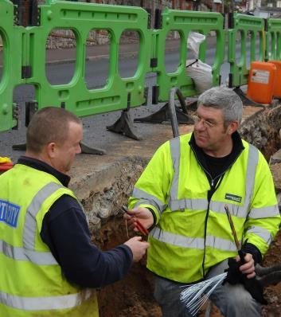
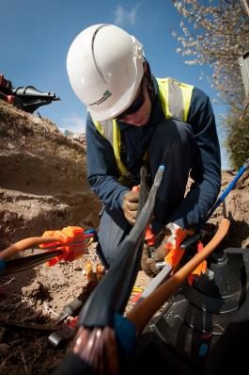
Planned power cuts
- Our approach
Significant network investment (e.g. to replace aging assets) requires planned power cuts
Prior notification (minimum 5 days in advance)
Attempt to schedule at most convenient time – but always cant please everyone
Minimise disruption and duration where possible
25

Slide 26
Quality of supply
- Our approach
Supply voltage can sometimes be adversely affected by:
  Damage to the electrical network
  Network switching (to restore supplies during power cuts)
  Lightning
  Electrical equipment connected to the network that uses a large amount of current or that frequently switches on and off. e.g. Electric motors; welders
    When issues occur the voltage usually dips for a few seconds and then returns to normal
    European legislation (1996) requires new electrical equipment to be designed to withstand types of disturbance normally found on any electricity supply network
    There are a number of devices available to reduce the effects:
Surge protectors Power filters | limit the maximum voltage reaching electrical equipment
Line conditioners | provide a regulated voltage and remove interference (e.g. used in factories where heavy machinery used nearby to computers and office equipment)
Uninterruptable Power Supplies (UPS) | maintain power even if electricity fails
26

Slide 27
Power cuts (reliability and resilience)
- Why we think its important for you
For our business customers reliability is a huge issue:
  Loss of productivity/trading impacts your business activities and hits your bottom line
  Staff down time
  Availability of information
We must ensure a reliable service by having a more resilient network
  Minimise frequency and duration of cuts, occurrence of dips/fluctuations
  Could WPD take steps to help businesses put resilience plans in place?
  Things to consider
    Do you have any sub-let tenants or adjacent tenants off your power supply?
    Do/should you have a generator/UPS? Has it been tested?
    What is the impact of a power cut on your IT infrastructure? Does it impact your security?
    Do you know who to contact (WPD)? Do you know how to contact (digital phones down)?
    Checking all supplies restored
    Insurance for loss of business
27

Slide 28
Workshop 2 – Discussion questions
Do you agree it is important to raise awareness of WPD amongst small/medium businesses?
What actions can WPD take to most effectively improve awareness?
What are the main impacts on your business / your members’ businesses when you experience a loss of power?
What actions can WPD take to improve:
  Our services
  The self-resilience of small/medium businesses?
28

Slide 29
COFFEE BREAK
Notes:
Introduce WPD team
Alison
Bob
Nigel
Phil
Natasha
Also EDCM – Mike/Simon

Slide 30
Session 3:
  Developing a WPD action plan with respect to:
    Connections
    Street works
Alison Sleightholm
Regulatory & Government Affairs Manager

Slide 31
Connections
- Our approach
We deal with approximately 50,000 connection enquiries a year
We connect approximately 36,000 new sites a year
  35,000 small sites connected at LV
  1000 large sites connected at HV
  20 very large sites connected at EHV
A key change has been the increase in the number of generation connected to the distribution system
We have connected over 4000MW of generation
Much of the electricity network is now constrained or at capacity due to the amount of DG (distributed generation) that has connected
Notes:
Does not include small scale generation or connections to our network by others

Slide 32
The key stages in the process
Information
Application
Quotation and Agreements
Construction and Connection
Call us, apply online or send an Application Form (with plans enclosed)
We calculate the Charge & send an Offer showing Contestable and Non-contestable costs
Decide if you want WPD to do all the work (or appoint an ICP for the Contestable work)
We contact to discuss a date for work and any other requirements e.g. obtaining Wayleaves or consents and completing a Connection Agreement
If you want WPD to carry out all the work, sign and return the Offer acceptance, with payment
If using one, appoint an ICP and ask them to apply to us for an Offer
Register your new supply MPAN with an electricity supplier and arrange your metering
Before we visit, please complete any on- site works you are providing
We complete the works and energise your connection
32

Slide 33
Typical timescales for connection
Quotations
The timescales for WPD to provide a quotation for contestable quotations are
  45 working days for LV generator connections
  65 working days for HV and EHV generation connections
Compensation is paid if WPD miss these deadlines
There are other standards that apply throughout the connections process
Completed work
Generator Size | Location | Typical Connection Voltage | Typical Timescale
0 – 0.25 MW | Rural | 400V | 4-6 months
0 – 0.5 MW | Urban | 400V | 4-6 months
0.25 – 4.0 MW | Rural | 11,000 V | 12-24 months
0.5 – 7.0 MW | Urban | 11,000 V | 12-24 months
4.0 – 20 MW | Rural | 33,000 V | 12-24 months
7.0 – 20 MW | Urban | 33,000 V | 12-24 months
+ 20 MW | Rural & Urban | 132,000 V | >24 months
Notes:
A key determinant of the timescale is whether the connection is “simple” – sole use assets or involves reinforcement
Generally the higher the voltage of connection the higher the cost
+50MW = NG

Slide 34
Connections
- Why we think its important to you
Cost
Breakdown/explanation of the cost
Clarity of information
Ease of applying
Understanding the process
Speed of quotation
Timeliness of the completed connection
Availability of capacity
34

Slide 35
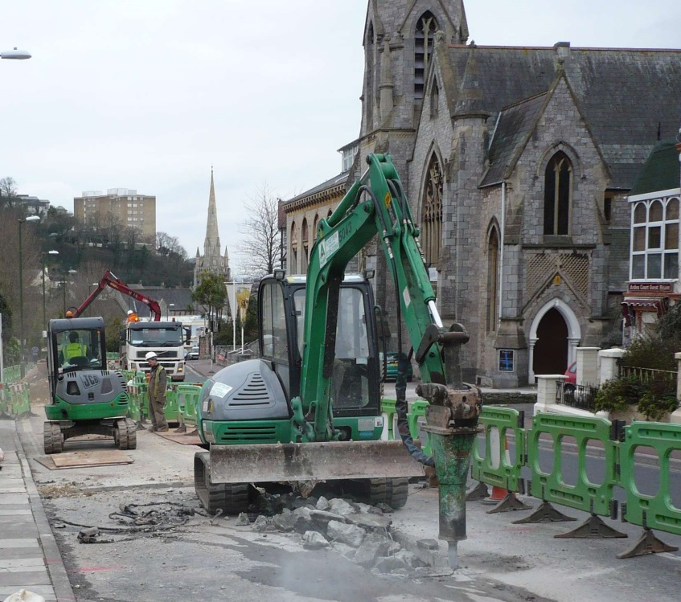
Street works
- Why we think its important to you
Our investment on the network leads to work schemes that require street works in roads, footpaths and high-streets
In the last 12 months we have conducted 34,212 works
Wherever possible we seek to co-ordinate works with other utilities
Key issues for customers include:
  Amount of information/advanced warning
  Timing of works
  Duration
  Accessibility
35

Slide 36
Workshop 3 – Discussion questions
Have you or your members’ had experience of applying for a new connection?
    If so, how did you find our service?
What actions can WPD take to improve the connections service for small/medium businesses?
Have you or your members’ had experience of street-works and, if so, how has this affected your / their business?
What actions can WPD take to ensure the effects of street-works on your business / your members’ businesses are minimised?
Do you have any further comments on today’s workshop or any other topics you would like to raise today?
How would you like to be kept informed of the impact of the delivery of the Business Plan on customer bills?
36

Slide 37
Thank you for attending
Slides and feedback will be posted on the website www.westernpower.co.uk
We would appreciate feedback on any of the areas discussed today. Please contact:
Alison Sleightholm, Regulation and Government Affairs Manager
      email: asleightholm@westernpower.co.uk
      phone: 0117 933 2175
37

